Slide 1
Graph Neural Networks: Models and Applications
Yao Ma, Wei Jin, and Jiliang Tang, Michigan State University
Lingfei Wu and Tengfei Ma, IBM Research
Tutorial website: http://cse.msu.edu/~mayao4/tutorials/aaai2020/

Slide 2
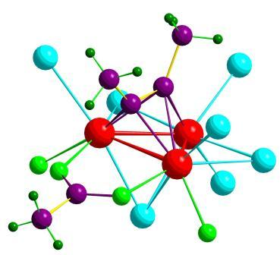
Data as Graphs - Explicit
Social Graphs
Transportation Graphs
Brain Graphs
Web Graphs
Molecular Graphs
Gene Graphs

Slide 3
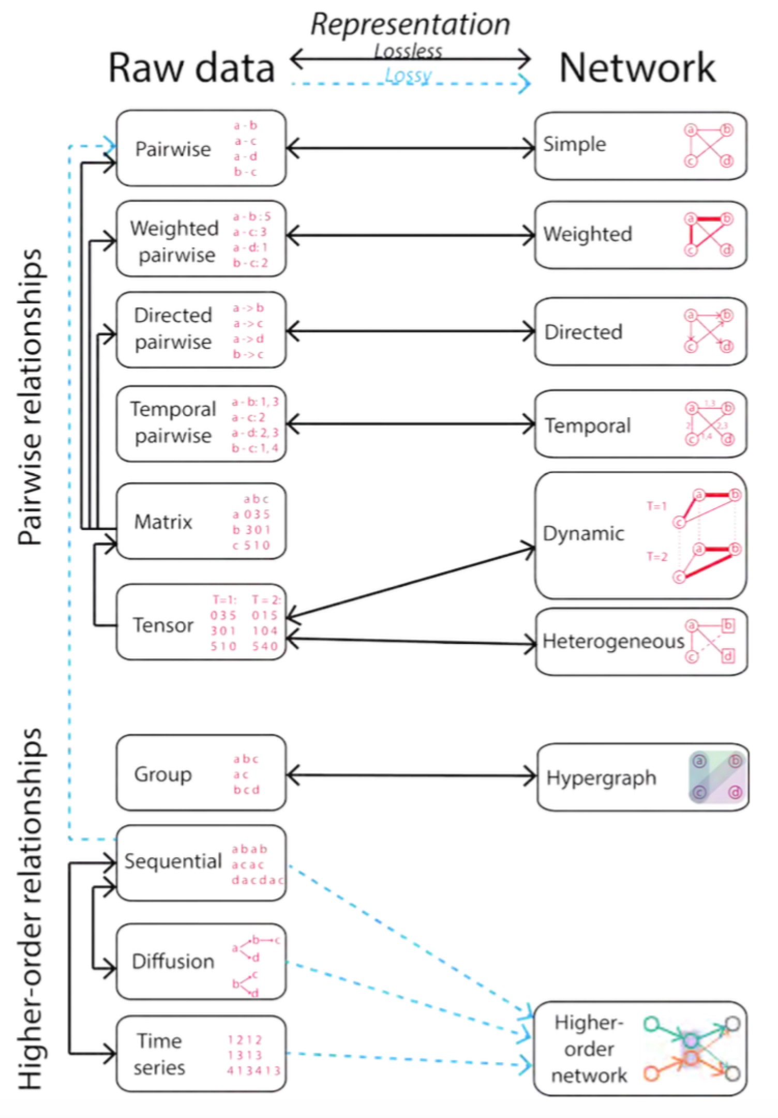

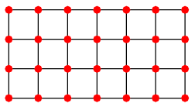
Data as Graphs - Implicit
Jian Xu. Representing Big Data as Networks. PhD Dissertation, University of Notre Dame

Slide 4
ML on Graphs
Numerous real-world problems can be summarized as a set of tasks on graphs
Link prediction
Node Classification
Community Detection
Ranking ….
ML solutions
Classification
Clustering
Traditional
i.i.d. data
Graphs
…..
Feature/Representation
Ranking
Notes:
Implicit → graph (image)
lattice graph
Feature/representation learning is the key. Not necessary can achieve the performance as traditional methods

Slide 5

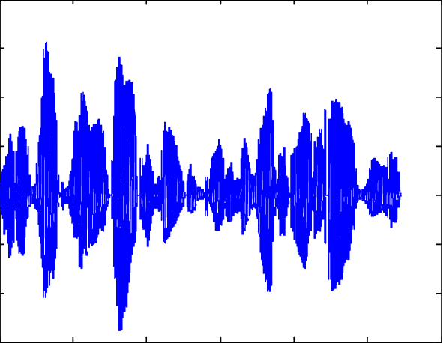
The Power of Deep Learning

Slide 6
Deep Learning Meets Graphs: Challenges
Traditional DL is designed for simple grids or sequences
CNNs for fixed-size images/grids
RNNs for text/sequences
But nodes on graphs have different connections
Arbitrary neighbor size
Complex topological structure
No fixed node ordering

Slide 7

Graph Neural Networks
Representations
Graph-level
Activation Function
Node-level
Graph Convolutions
Graph Convolutions

Slide 8
Tutorial Overview
Foundations
Models
Applications
Spectral-based GNN
Basic Graph Theory
Healthcare
Spatial-based GNN
Spectral Graph Theory
Pooling Layers in GNN
Natural Language Processing
Graph Fourier Analysis
Robustness of GNN
Scalable Learning for GNN
Recommendations

Slide 9
Two More Things

Slide 10
A Book
Foundations
Models
Applications
Spectral-based GNN
Basic Graph Theory
Healthcare
Spatial-based GNN
Spectral Graph Theory
Pooling Layers in GNN
Natural Language Processing
Graph Fourier Analysis
Robustness of GNN
Scalable Learning for GNN
Recommendations
Feature Selection on Graphs
Graph Embedding
More advances in Models
Other Deep models on Graphs
GNNs for Complex Graphs
Data Mining
Computer Vision
Biology, Chemistry and Physics

Slide 11



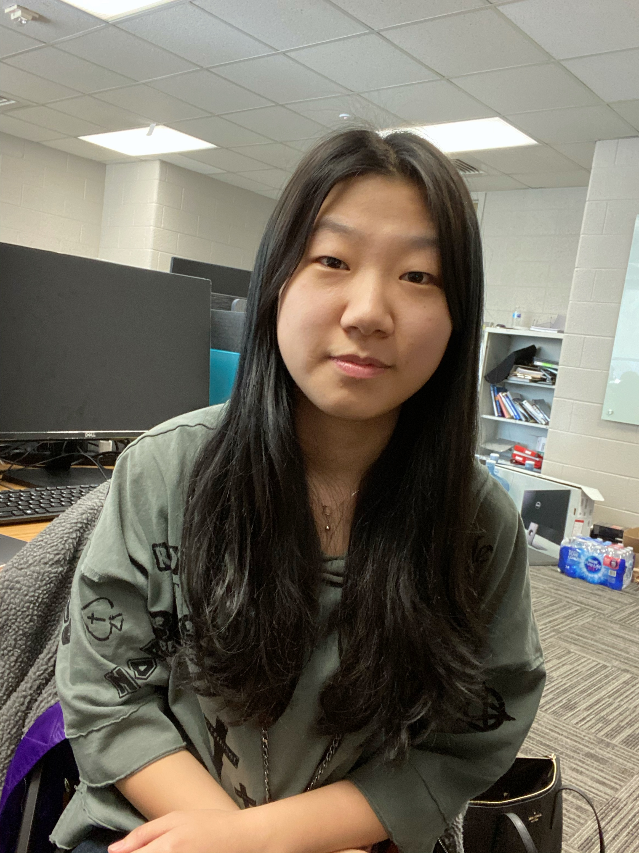

A Repository
GraphRobust: A repository about adversarial attacks and defenses on graph data
DeepRobust: A repository about general adversarial attacks and defenses

Slide 12
Tutorial Overview
Foundations
Models
Applications
Spectral-based GNN
Basic Graph Theory
Healthcare
Spatial-based GNN
Spectral Graph Theory
Pooling Layers in GNN
Natural Language Processing
Graph Fourier Analysis
Robustness of GNN
Scalable Learning for GNN
Recommendations

Slide 13
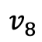
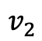
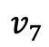
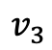
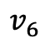
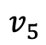
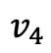
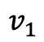
Graphs and Graph Signals
$$v_{7}$$
$$v_{8}$$
$$v_{1}$$
$$v_{3}$$
$$v_{6}$$
$$v_{5}$$
$$v_{2}$$
$$v_{4}$$

Slide 14
Graphs and Graph Signals
Graph Signal:

Slide 15
Graphs and Graph Signals
Graph Signal:

Slide 16
Graphs and Graph Signals
Graph Signal:

Slide 17
Matrix Representations of Graphs
$$v_{7}$$
$$v_{8}$$
$$v_{1}$$
$$v_{3}$$
$$v_{6}$$
$$v_{5}$$
$$v_{2}$$
$$v_{4}$$
Spectral graph theory. American Mathematical Soc.; 1997.

Slide 18
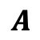
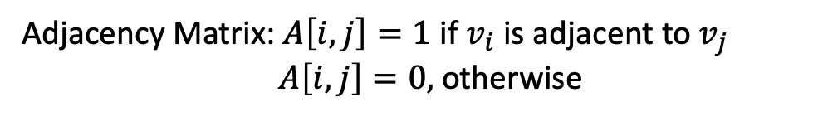
Matrix Representations of Graphs
$$v_{7}$$
$$v_{8}$$
$$v_{1}$$
$$v_{3}$$
Adjacency Matrix: $A\left[i,j\right]=1$ if $v_{i}$ is adjacent to $v_{j}$
$A\left[i,j\right]=0,$ otherwise
$$v_{6}$$
$$v_{5}$$
$$v_{2}$$
$$v_{4}$$
Adjacency Matrix
$$A$$
Spectral graph theory. American Mathematical Soc.; 1997.

Slide 19
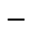

Matrix Representations of Graphs
$$v_{7}$$
$$v_{8}$$
$$v_{1}$$
$$v_{3}$$
Adjacency Matrix: $A\left[i,j\right]=1$ if $v_{i}$ is adjacent to $v_{j}$
$A\left[i,j\right]=0,$ otherwise
$$v_{6}$$
$$v_{5}$$
$$v_{2}$$
Degree Matrix:
$$v_{4}$$
Degree Matrix
Adjacency Matrix
$$−$$
$$D$$
$$A$$
Spectral graph theory. American Mathematical Soc.; 1997.

Slide 20
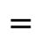
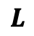
Matrix Representations of Graphs
$$v_{7}$$
$$v_{8}$$
$$v_{1}$$
$$v_{3}$$
Adjacency Matrix: $A\left[i,j\right]=1$ if $v_{i}$ is adjacent to $v_{j}$
$A\left[i,j\right]=0,$ otherwise
$$v_{6}$$
$$v_{5}$$
$$v_{2}$$
Degree Matrix:
$$v_{4}$$
Degree Matrix
Adjacency Matrix
Laplacian Matrix
$$−$$
$$=$$
$$D$$
$$A$$
$$L$$
Spectral graph theory. American Mathematical Soc.; 1997.

Slide 21
Laplacian Matrix as an Operator
Laplacian matrix is a difference operator:

Slide 22
Laplacian Matrix as an Operator
Laplacian matrix is a difference operator:

Slide 23
Laplacian Matrix as an Operator
Laplacian matrix is a difference operator:
Laplacian quadratic form:

Slide 24
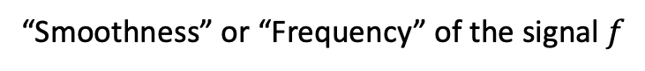
Laplacian Matrix as an Operator
Laplacian matrix is a difference operator:
Laplacian quadratic form:
“Smoothness” or “Frequency” of the signal $f$

Slide 25
Laplacian Matrix as an Operator
Laplacian matrix is a difference operator:
Low frequency graph signal
Laplacian quadratic form:
“Smoothness” or “Frequency” of the signal $f$

Slide 26
Laplacian Matrix as an Operator
Laplacian matrix is a difference operator:
Low frequency graph signal
Laplacian quadratic form:
“Smoothness” or “Frequency” of the signal $f$
High frequency graph signal

Slide 27
Eigen-decomposition of Laplacian Matrix
Laplacian matrix has a complete set of orthonormal eigenvectors:

Slide 28

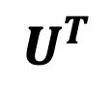
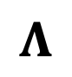
Eigen-decomposition of Laplacian Matrix
Laplacian matrix has a complete set of orthonormal eigenvectors:
$$U$$
$$Λ$$
$$U^{T}$$

Slide 29
Eigen-decomposition of Laplacian Matrix
Laplacian matrix has a complete set of orthonormal eigenvectors:
$$U$$
$$Λ$$
$$U^{T}$$
Eigenvalues are sorted non-decreasingly:

Slide 30
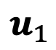
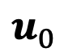
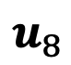
Eigenvectors as Graph Signals
$$u_{0}$$
$$u_{1}$$
$$u_{8}$$

Slide 31
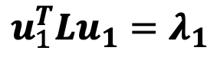
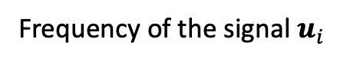
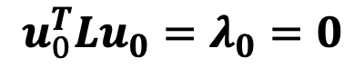
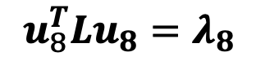
Eigenvectors as Graph Signals
The frequency of an eigenvector of Laplacian matrix is its corresponding eigenvalue:
Frequency of the signal $u_{i}$
$$u_{0}$$
$$u_{1}$$
$$u_{8}$$
$$u_{0}^{T}Lu_{0}=λ_{0}=0$$
$$u_{1}^{T}Lu_{1}=λ_{1}$$
$$u_{8}^{T}Lu_{8}=λ_{8}$$

Slide 32
Eigenvectors as Graph Signals
The frequency of an eigenvector of Laplacian matrix is its corresponding eigenvalue:
Frequency of the signal $u_{i}$
$$u_{0}$$
$$u_{1}$$
$$u_{8}$$
Low frequency
High frequency
$$u_{0}^{T}Lu_{0}=λ_{0}=0$$
$$u_{1}^{T}Lu_{1}=λ_{1}$$
$$u_{8}^{T}Lu_{8}=λ_{8}$$

Slide 33
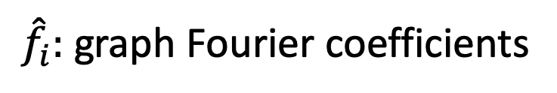
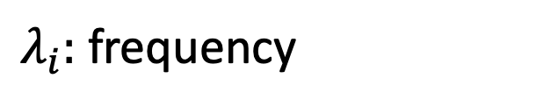
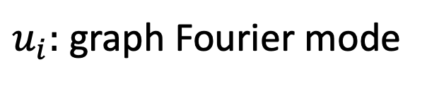
Graph Fourier Transform
A signal $f$ can be written as graph Fourier series:
$u_{i}:$ graph Fourier mode
$λ_{i}:$ frequency
${\hat{f}}_{i}:$ graph Fourier coefficients

Slide 34
Graph Fourier Transform
A signal $f$ can be written as graph Fourier series:
$u_{i}:$ graph Fourier mode
$λ_{i}:$ frequency
${\hat{f}}_{i}:$ graph Fourier coefficients

Slide 35
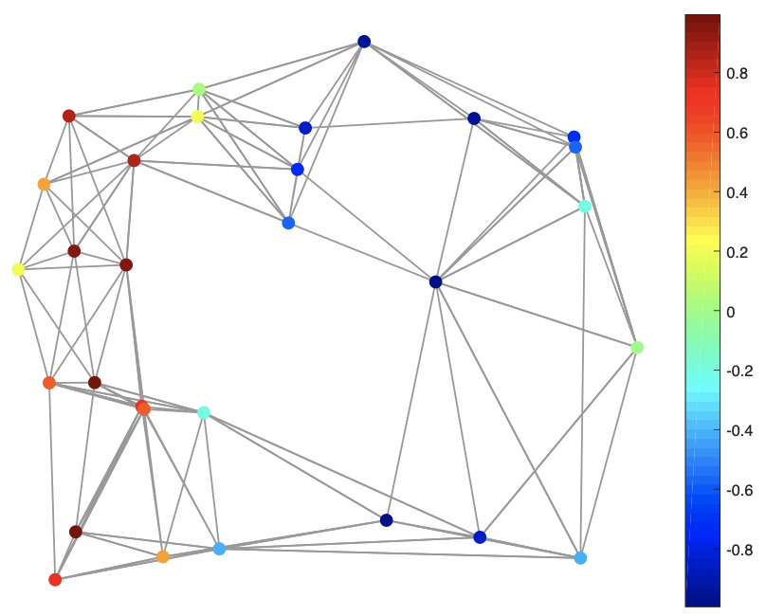
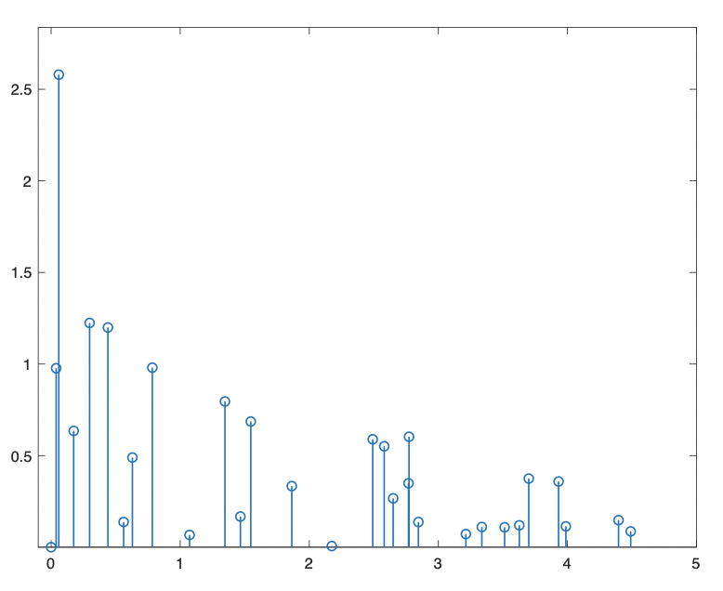
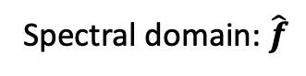
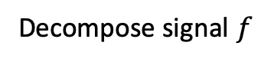
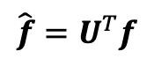
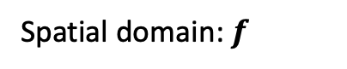
Graph Fourier Transform (GFT)
A signal $f$ can be written as graph Fourier series:
$u_{i}:$ graph Fourier mode
$λ_{i}:$ frequency
${\hat{f}}_{i}:$ graph Fourier coefficients
$$\hat{f}=U^{T}f$$
Decompose signal $f$
Spatial domain: $f$
Spectral domain: $\hat{f}$
The emerging field of signal processing on graphs: Extending high-dimensional data analysis to networks and other irregular domains. IEEE signal processing magazine

Slide 36
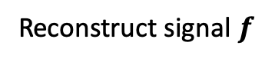
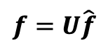
Inverse Graph Fourier Transform (IGFT)
A signal $f$ can be written as graph Fourier series:
$u_{i}:$ graph Fourier mode
$λ_{i}:$ frequency
${\hat{f}}_{i}:$ graph Fourier coefficients
$$f=U\hat{f}$$
Reconstruct signal $f$
Spatial domain: $f$
Spectral domain: $\hat{f}$

Slide 37
Tutorial Overview
Foundations
Models
Applications
Spectral-based GNN
Basic Graph Theory
Healthcare
Spatial-based GNN
Spectral Graph Theory
Pooling Layers in GNN
Natural Language Processing
Graph Fourier Analysis
Robustness of GNN
Scalable Learning for GNN
Recommendations

Slide 38
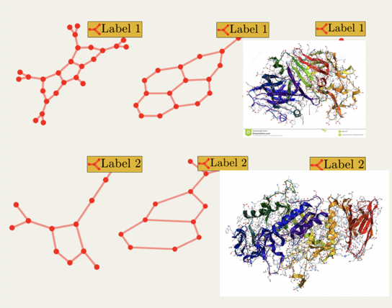
Tasks on Graph-Structured Data
Node-level
Graph-level
Link Prediction
Graph Classification
？
？
t
t+a
Node Classification
？
？
？

Slide 39
Tasks on Graph-Structured Data
Node-level
Graph-level

Slide 40
Tasks on Graph-Structured Data
Node-level
Graph-level
Node Representations

Slide 41
Tasks on Graph-Structured Data
Node-level
Graph-level
Node Representations
Graph Representation

Slide 42
Tasks on Graph-Structured Data
Node-level
Graph-level
Filtering
Pooling
Node Representations
Graph Representations

Slide 43
Two Main Operations in GNN
Graph Filtering
Graph Filtering

Slide 44
Two Main Operations in GNN
Graph Filtering
Graph Filtering

Slide 45
Two Main Operations in GNN
Graph Filtering
Graph Filtering
Graph filtering refines the node features

Slide 46
Two Main Operations in GNN
Graph Pooling
Graph Pooling

Slide 47
Two Main Operations in GNN
Graph Pooling
Graph Pooling

Slide 48
Two Main Operations in GNN
Graph Pooling
Graph Pooling
Graph pooling generates a smaller graph

Slide 49
General GNN Framework
For node-level tasks
Filtering Layer
Activation
…

Slide 50
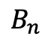
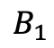
General GNN Framework
For graph-level tasks
Filtering Layer
Activation
Pooling Layer
…
…
…
$$B_{1}$$
$$B_{n}$$

Slide 51
Graph Filtering Operation
Graph Filtering

Slide 52
Two Types of Graph Filtering Operation
Spatial Based Filtering
Spectral Based Filtering
Original GNN
(Scarselli et al.
2005)
GraphSage
(Hamilton et al.
NIPS 2017)
Spectral
Graph CNN
(Bruna et al.
ICLR 2014)
GAT
(Veličković et al.
ICLR 2018)
GCN
(Kipf & Welling.
ICLR 2017)
MPNN
(Glimer et al.
ICML 2017)
ChebNet
(Defferard et al.
NIPS 2016)
…

Slide 53
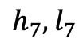
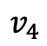
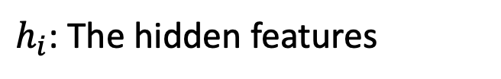
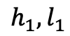
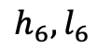
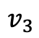
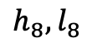
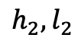










Graph Filtering in the First GNN Paper
$h_{i}$: The hidden features
$${h_{3},l}_{3}$$
$$v_{3}$$
$$v_{4}$$
$${h_{4},l}_{4}$$
$l_{i}$: The input features
$${h_{1},l}_{1}$$
$$v_{1}$$
$${h_{2},l}_{2}$$
$${h_{5},l}_{5}$$
$$v_{5}$$
$$v_{2}$$
$$v_{8}$$
$${h_{8},l}_{8}$$
$${h_{6},l}_{6}$$
$$v_{6}$$
$$v_{7}$$
$${h_{7},l}_{7}$$
Graph neural networks for ranking web pages. WI. IEEE, 2005.

Slide 54



Graph Filtering in the First GNN Paper
$h_{i}$: The hidden features
$${h_{3},l}_{3}$$
$$v_{3}$$
$$v_{4}$$
$${h_{4},l}_{4}$$
$l_{i}$: The input features
$${h_{1},l}_{1}$$
$$v_{1}$$
$${h_{2},l}_{2}$$
$${h_{5},l}_{5}$$
$$v_{5}$$
$$v_{2}$$
$$v_{8}$$
$${h_{8},l}_{8}$$
$${h_{6},l}_{6}$$
$$v_{6}$$
$$h_{i}^{(k+1)}=\sum_{v_{j}∈N(v_{i})}{f\left(l_{i},h_{j}^{(k)},l_{j}\right), ∀{ v}_{i}∈V.}$$
$$v_{7}$$
$${h_{7},l}_{7}$$
$N(v_{i}):$ Neighbors of the node $v_{i}$.
$f\left(⋅\right):$ Feedforward neural network.

Slide 55




Graph Spectral Filtering for Graph Signal
Recall:
$$GFT:\hat{f}=U^{T}f$$
$$IGFT:f=U\hat{f}$$
Filter a graph signal $f$:
$$f$$

Slide 56


Graph Spectral Filtering for Graph Signal
Recall:
$$GFT:\hat{f}=U^{T}f$$
$$IGFT:f=U\hat{f}$$
Filter a graph signal $f$:
$$f$$
$$GFT$$
$$u_{i}^{T}f$$
Decompose
Coefficients

Slide 57



Graph Spectral Filtering for Graph Signal
Recall:
$$GFT:\hat{f}=U^{T}f$$
$$IGFT:f=U\hat{f}$$
Filter a graph signal $f$:
$$f$$
$$GFT$$
$$u_{i}^{T}f$$
$$\hat{g}(λ_{i})$$
$$\hat{g}\left(λ_{i}\right)⋅u_{i}^{T}f$$
Decompose
Filter
Coefficients
Filtered coefficients
Filter $\hat{g}\left(λ_{i}\right):$ Modulating the frequency

Slide 58

Graph Spectral Filtering for Graph Signal
Recall:
$$GFT:\hat{f}=U^{T}f$$
$$IGFT:f=U\hat{f}$$
Filter a graph signal $f$:
$$f$$
$$GFT$$
$$u_{i}^{T}f$$
$$\hat{g}(λ_{i})$$
$$\hat{g}\left(λ_{i}\right)⋅u_{i}^{T}f$$
Decompose
Filter
Coefficients
Filtered coefficients
Example:
Filter $\hat{g}\left(λ_{i}\right):$ Modulating the frequency
$$\hat{g}$$
$$\hat{g}$$
$$\hat{g}$$
$$λ_{i}$$
$$λ_{i}$$
$$λ_{i}$$

Slide 59


Graph Spectral Filtering for Graph Signal
Recall:
$$GFT:\hat{f}=U^{T}f$$
$$IGFT:f=U\hat{f}$$
Filter a graph signal $f$:
$$GFT$$
$$\hat{g}(λ_{i})$$
$$IGFT$$
$$\sum_{i=0}^{N−1}{\hat{g}\left(λ_{i}\right)⋅u_{i}^{T}f⋅u_{i}}$$
$$f$$
$$u_{i}^{T}f$$
$$\hat{g}\left(λ_{i}\right)⋅u_{i}^{T}f$$
Decompose
Filter
Reconstruct
Coefficients
Filtered coefficients
Example:
Filter $\hat{g}\left(λ_{i}\right):$ Modulating the frequency
$$\hat{g}$$
$$\hat{g}$$
$$\hat{g}$$
$$λ_{i}$$
$$λ_{i}$$
$$λ_{i}$$

Slide 60





Graph Spectral Filtering for Graph Signal
Recall:
$$GFT:\hat{f}=U^{T}f$$
$$IGFT:f=U\hat{f}$$
Filter a graph signal $f$:
$$GFT$$
$$\hat{g}(Λ)$$
$$IGFT$$
$$U{\hat{g}(Λ)U}^{T}f$$
$$f$$
$$U^{T}f$$
$${\hat{g}(Λ)U}^{T}f$$
Decompose
Filter
Reconstruct
Coefficients
Filtered coefficients
Example:
$$\hat{g}$$
$$\hat{g}$$
$$\hat{g}$$
$$λ_{i}$$
$$λ_{i}$$
$$λ_{i}$$

Slide 61

Graph Spectral Filtering for Graph Signal
Recall:
$$GFT:\hat{f}=U^{T}f$$
$$IGFT:f=U\hat{f}$$
Filter a graph signal $f$:
$$GFT$$
$$\hat{g}(Λ)$$
$$IGFT$$
$$U{\hat{g}(Λ)U}^{T}f$$
$$f$$
$$U^{T}f$$
$${\hat{g}(Λ)U}^{T}f$$
Decompose
Filter
Reconstruct
Coefficients
Filtered coefficients
$$\hat{g}(L)$$
Example:
$$\hat{g}$$
$$\hat{g}$$
$$\hat{g}$$
$$λ_{i}$$
$$λ_{i}$$
$$λ_{i}$$

Slide 62


Graph Spectral Filtering for Graph Signal
Recall:
$$GFT:\hat{f}=U^{T}f$$
$$IGFT:f=U\hat{f}$$
Filter a graph signal $f$:
$$GFT$$
$$\hat{g}(Λ)$$
$$IGFT$$
$$U{\hat{g}(Λ)U}^{T}f$$
$$f$$
$$U^{T}f$$
$${\hat{g}(Λ)U}^{T}f$$
Decompose
Filter
Reconstruct
Coefficients
Filtered coefficients
$$\hat{g}(L)$$
$$f$$
$$\hat{g}(L)f$$
Filtering

Slide 63
Graph Spectral Filtering for GNN
How to design the filter?

Slide 64

Graph Spectral Filtering for GNN
How to design the filter?
Data-driven! Learn $\hat{g}(Λ)$ from data!

Slide 65

Graph Spectral Filtering for GNN
How to design the filter?
Data-driven! Learn $\hat{g}(Λ)$ from data!
How to deal with multi-channel signals?
$F_{in}∈ℝ^{N×d_{1}}→F_{out}∈ℝ^{N×d_{2}}$.

Slide 66
Graph Spectral Filtering for GNN
How to design the filter?
Data-driven! Learn $\hat{g}(Λ)$ from data!
How to deal with multi-channel signals?
$F_{in}∈ℝ^{N×d_{1}}→F_{out}∈ℝ^{N×d_{2}}$.
Each input channel contributes to each output channel

Slide 67

Graph Spectral Filtering for GNN
How to design the filter?
Data-driven! Learn $\hat{g}(Λ)$ from data!
How to deal with multi-channel signals?
$F_{in}∈ℝ^{N×d_{1}}→F_{out}∈ℝ^{N×d_{2}}$.
Each input channel contributes to each output channel
$$F_{out}\left[:,i\right]=\sum_{j=1}^{d_{1}}{{\hat{g}}_{ij}\left(L\right)F_{in}\left[:,j\right] i=1,…d_{2}}$$
Filter each input channel

Slide 68

Graph Spectral Filtering for GNN
How to design the filter?
Data-driven! Learn $\hat{g}(Λ)$ from data!
How to deal with multi-channel signals?
$F_{in}∈ℝ^{N×d_{1}}→F_{out}∈ℝ^{N×d_{2}}$.
Each input channel contributes to each output channel
$$F_{out}\left[:,i\right]=\sum_{j=1}^{d_{1}}{{\hat{g}}_{ij}\left(L\right)F_{in}\left[:,j\right] i=1,…d_{2}}$$
Learn $d_{2}×d_{1}$ filters
Filter each input channel

Slide 69

$\hat{g}(Λ)$: Non-parametric

Slide 70

$\hat{g}(Λ)$: Non-parametric
Spectral Networks and Locally Connected Networks on Graphs. ICLR 2014

Slide 71

$\hat{g}(Λ)$: Non-parametric
$d_{2}×d_{1}×N$ parameters

Slide 72

$\hat{g}(Λ)$: Non-parametric
$d_{2}×d_{1}×N$ parameters
$$U{\hat{g}(Λ)U}^{T}f$$
Expensive eigen-decomposition

Slide 73


$\hat{g}(Λ)$ : Polynomial Parametrized
Convolutional Neural Networks on Graphs with Fast Localized Spectral Filtering. NIPS 2016.

Slide 74

$\hat{g}(Λ)$ : Polynomial Parametrized
$d_{2}×d_{1}×K$ parameters

Slide 75

$\hat{g}(Λ)$ : Polynomial Parametrized
$d_{2}×d_{1}×K$ parameters
$$U\hat{g}\left(Λ\right)U^{T}f=\sum_{k=0}^{K}{θ_{k}L^{k}}f$$

Slide 76
$\hat{g}(Λ)$ : Polynomial Parametrized
$d_{2}×d_{1}×K$ parameters
$$U\hat{g}\left(Λ\right)U^{T}f=\sum_{k=0}^{K}{θ_{k}L^{k}}f$$
No eigen-decomposition needed

Slide 77
Polynomial Parametrized Filter: a Spatial View

Slide 78

Polynomial Parametrized Filter: a Spatial View
If the node $v_{j}$ is more than $K$-hops away from node $v_{i}$, then,

Slide 79
Polynomial Parametrized Filter: a Spatial View
If the node $v_{j}$ is more than $K$-hops away from node $v_{i}$, then,
The filter is localized within $K$-hops neighbors in the spatial domain

Slide 80
Chebyshev Polynomials
The polynomials adopted have non-orthogonal basis $1, x, x^{2}, x^{3},…$

Slide 81
Chebyshev Polynomials
The polynomials adopted have non-orthogonal basis $1, x, x^{2}, x^{3},…$
Unstable under perturbation of coefficients

Slide 82
Chebyshev Polynomials
The polynomials adopted have non-orthogonal basis $1, x, x^{2}, x^{3},…$
Unstable under perturbation of coefficients
Chebyshev polynomials:

Slide 83

Chebyshev Polynomials
The polynomials adopted have non-orthogonal basis $1, x, x^{2}, x^{3},…$
Unstable under perturbation of coefficients
Chebyshev polynomials:
Recursive definition:
$T_{0}\left(x\right)=1;T_{1}\left(x\right)=x$
$T_{k}\left(x\right)=2xT_{k−1}\left(x\right)−T_{k−2}(x)$

Slide 84

Chebyshev Polynomials
The polynomials adopted have non-orthogonal basis $1, x, x^{2}, x^{3},…$
Unstable under perturbation of coefficients
Chebyshev polynomials:
Recursive definition:
$T_{0}\left(x\right)=1;T_{1}\left(x\right)=x$
$T_{k}\left(x\right)=2xT_{k−1}\left(x\right)−T_{k−2}(x)$
The Chebyshev polynomials $\left\{T_{k}\right\}$ form an orthogonal basis for the Hilbert space $L^{2}(\left[−1,1\right],\frac{dy}{\sqrt{1−y^{2}}})$.

Slide 85
Chebyshev Polynomials
The polynomials adopted have non-orthogonal basis $1, x, x^{2}, x^{3},…$
Unstable under perturbation of coefficients
Chebyshev polynomials:
Recursive definition:
$T_{0}\left(x\right)=1;T_{1}\left(x\right)=x$
$T_{k}\left(x\right)=2xT_{k−1}\left(x\right)−T_{k−2}(x)$
The Chebyshev polynomials $\left\{T_{k}\right\}$ form an orthogonal basis for the Hilbert space $L^{2}(\left[−1,1\right],\frac{dy}{\sqrt{1−y^{2}}})$.

Slide 86

ChebNet
Parametrize $\hat{g}(Λ)$ with Chebyshev polynomials
Convolutional Neural Networks on Graphs with Fast Localized Spectral Filtering. NIPS 2016.

Slide 87
ChebNet
Parametrize $\hat{g}(Λ)$ with Chebyshev polynomials
$d_{2}×d_{1}×K$ parameters

Slide 88

ChebNet
Parametrize $\hat{g}(Λ)$ with Chebyshev polynomials
$d_{2}×d_{1}×K$ parameters
$U\hat{g}\left(Λ\right)U^{T}f=\sum_{k=0}^{K}{θ_{k}T_{k}(\tilde{L})}f$, with $\tilde{L}=\frac{2L}{λ_{max}}−I$
No eigen-decomposition needed

Slide 89
ChebNet
Parametrize $\hat{g}(Λ)$ with Chebyshev polynomials
$d_{2}×d_{1}×K$ parameters
$U\hat{g}\left(Λ\right)U^{T}f=\sum_{k=0}^{K}{θ_{k}T_{k}(\tilde{L})}f$, with $\tilde{L}=\frac{2L}{λ_{max}}−I$
No eigen-decomposition needed
Stable under perturbation of coefficients

Slide 90
GCN: Simplified ChebNet
Use Chebyshev polynomials with $K=1$ and assume $λ_{max}=2$
Semi-Supervised Classification with Graph Convolutional Networks. ICLR 2017.

Slide 91

GCN: Simplified ChebNet
Use Chebyshev polynomials with $K=1$ and assume $λ_{max}=2$
Further constrain ${θ=θ}_{0}=−θ_{1}$

Slide 92
GCN: Simplified ChebNet
Use Chebyshev polynomials with $K=1$ and assume $λ_{max}=2$
Further constrain ${θ=θ}_{0}=−θ_{1}$
Apply a renormalization trick

Slide 93

GCN for Multi-channel Signal
Recall:
$$F_{out}\left[:,i\right]=\sum_{j=1}^{d_{1}}{{\hat{g}}_{ij}\left(L\right)F_{in}\left[:,j\right] i=1,…d_{2}}$$
Filter each input channel

Slide 94

GCN for Multi-channel Signal
Recall:
$$F_{out}\left[:,i\right]=\sum_{j=1}^{d_{1}}{{\hat{g}}_{ij}\left(L\right)F_{in}\left[:,j\right] i=1,…d_{2}}$$
Filter each input channel
For GCN:
$$F_{out}\left[:,i\right]=\sum_{j=1}^{d_{1}}{θ_{ji}{(\tilde{D}}^{−\frac{1}{2}}\tilde{A}{\tilde{D}}^{−\frac{1}{2}})F_{in}\left[:,j\right] i=1,…d_{2}}$$
GCN filter

Slide 95

GCN for Multi-channel Signal
Recall:
$$F_{out}\left[:,i\right]=\sum_{j=1}^{d_{1}}{{\hat{g}}_{ij}\left(L\right)F_{in}\left[:,j\right] i=1,…d_{2}}$$
Filter each input channel
For GCN:
$$F_{out}\left[:,i\right]=\sum_{j=1}^{d_{1}}{θ_{ji}{(\tilde{D}}^{−\frac{1}{2}}\tilde{A}{\tilde{D}}^{−\frac{1}{2}})F_{in}\left[:,j\right] i=1,…d_{2}}$$
GCN filter
In matrix form:
$$F_{out}= {(\tilde{D}}^{−\frac{1}{2}}\tilde{A}{\tilde{D}}^{−\frac{1}{2}})F_{in}Θ \text{with} Θ∈ℝ^{d_{1}×d_{2}} and Θ\left[j,i\right]=θ_{ji}$$

Slide 96

















A Spatial View of GCN Filter
Denote $C={\tilde{D}}^{−\frac{1}{2}}\tilde{A}{\tilde{D}}^{−\frac{1}{2}}$
$$F[3,:]$$
$$v_{3}$$
$$v_{4}$$
$$F[4,:]$$
$$F[1,:]$$
$$v_{1}$$
$$F[2,:]$$
$$F[5,:]$$
$$v_{5}$$
$$v_{2}$$
$$v_{8}$$
$$F[8,:]$$
$$F[6,:]$$
$$v_{6}$$
$$v_{7}$$
$$F[7,:]$$

Slide 97


A Spatial View of GCN Filter
Denote $C={\tilde{D}}^{−\frac{1}{2}}\tilde{A}{\tilde{D}}^{−\frac{1}{2}}$
Then $F_{out}=$ ${CF}_{in}Θ$
For node $v_{i},$ ${ F}_{out}\left[i,:\right]=\sum_{j}{C\left[i,j\right]F_{in}\left[j,:\right]Θ}$
$$F[3,:]$$
$$v_{3}$$
$$v_{4}$$
$$F[4,:]$$
$$F[1,:]$$
$$v_{1}$$
$$F[2,:]$$
$$F[5,:]$$
$$v_{5}$$
$$v_{2}$$
$$v_{8}$$
$$F[8,:]$$
$$F[6,:]$$
$$v_{6}$$
$$v_{7}$$
$$F[7,:]$$

Slide 98

A Spatial View of GCN Filter
Denote $C={\tilde{D}}^{−\frac{1}{2}}\tilde{A}{\tilde{D}}^{−\frac{1}{2}}$
Then $F_{out}=$ ${CF}_{in}Θ$
For node $v_{i},$ ${ F}_{out}\left[i,:\right]=\sum_{j}{C\left[i,j\right]F_{in}\left[j,:\right]Θ}$
$$F[3,:]$$
Observe that:
$$v_{3}$$
$$F[4,:]$$
$$v_{4}$$
$$F[1,:]$$
$C[i,j]=0$ for $v_{j}∉N\left(v_{i}\right)∪\left\{v_{i}\right\}$
$$v_{1}$$
$$F[2,:]$$
$$F[5,:]$$
$$v_{5}$$
$$v_{2}$$
$$v_{8}$$
$$F[8,:]$$
$$F[6,:]$$
$$v_{6}$$
$$v_{7}$$
$$F[7,:]$$

Slide 99
A Spatial View of GCN Filter
Denote $C={\tilde{D}}^{−\frac{1}{2}}\tilde{A}{\tilde{D}}^{−\frac{1}{2}}$
Then $F_{out}=$ ${CF}_{in}Θ$
For node $v_{i},$ ${ F}_{out}\left[i,:\right]=\sum_{j}{C\left[i,j\right]F_{in}\left[j,:\right]Θ}$
$$F[3,:]$$
Observe that:
$$v_{3}$$
$$F[4,:]$$
$$v_{4}$$
$$F[1,:]$$
$C[i,j]=0$ for $v_{j}∉N\left(v_{i}\right)∪\left\{v_{i}\right\}$
$$v_{1}$$
$$F[2,:]$$
$$F[5,:]$$
$$v_{5}$$
$$v_{2}$$
$$v_{8}$$
$$F[8,:]$$
$$F[6,:]$$
Hence,
$$v_{6}$$
$$v_{7}$$
$$F[7,:]$$

Slide 100
A Spatial View of GCN Filter
Denote $C={\tilde{D}}^{−\frac{1}{2}}\tilde{A}{\tilde{D}}^{−\frac{1}{2}}$
Then $F_{out}=$ ${CF}_{in}Θ$
For node $v_{i},$ ${ F}_{out}\left[i,:\right]=\sum_{j}{C\left[i,j\right]F_{in}\left[j,:\right]Θ}$
$$F[3,:]$$
Observe that:
$$v_{3}$$
$$F[4,:]$$
$$v_{4}$$
$$F[1,:]$$
$C[i,j]=0$ for $v_{j}∉N\left(v_{i}\right)∪\left\{v_{i}\right\}$
$$v_{1}$$
$$F[2,:]$$
$$F[5,:]$$
$$v_{5}$$
$$v_{2}$$
$$v_{8}$$
$$F[8,:]$$
$$F[6,:]$$
Hence,
$$v_{6}$$
$$v_{7}$$
$$F[7,:]$$
Feature transformation

Slide 101
A Spatial View of GCN Filter
Denote $C={\tilde{D}}^{−\frac{1}{2}}\tilde{A}{\tilde{D}}^{−\frac{1}{2}}$
Then $F_{out}=$ ${CF}_{in}Θ$
For node $v_{i},$ ${ F}_{out}\left[i,:\right]=\sum_{j}{C\left[i,j\right]F_{in}\left[j,:\right]Θ}$
$$F[3,:]$$
Observe that:
$$v_{3}$$
$$F[4,:]$$
$$v_{4}$$
$$F[1,:]$$
$C[i,j]=0$ for $v_{j}∉N\left(v_{i}\right)∪\left\{v_{i}\right\}$
$$v_{1}$$
$$F[2,:]$$
$$F[5,:]$$
$$v_{5}$$
$$v_{2}$$
$$v_{8}$$
$$F[8,:]$$
$$F[6,:]$$
Hence,
$$v_{6}$$
$$v_{7}$$
$$F[7,:]$$
Feature transformation
Aggregation

Slide 102















Filter in GCN VS Filter in the First GNN
GCN: k-th layer
$${h_{3},l}_{3}$$
$$v_{3}$$
$$v_{4}$$
$${h_{4},l}_{4}$$
$${h_{1},l}_{1}$$
$$v_{1}$$
$${h_{2},l}_{2}$$
$${h_{5},l}_{5}$$
The first GNN: k-th layer
$$v_{5}$$
$$v_{2}$$
$$v_{8}$$
$${h_{8},l}_{8}$$
$${h_{6},l}_{6}$$
$$v_{6}$$
$$v_{7}$$
$${h_{7},l}_{7}$$

Slide 103
Filter in GCN VS Filter in the First GNN
GCN: k-th layer
$${h_{3},l}_{3}$$
$$v_{3}$$
$$v_{4}$$
$${h_{4},l}_{4}$$
$${h_{1},l}_{1}$$
$$v_{1}$$
$${h_{2},l}_{2}$$
$${h_{5},l}_{5}$$
The first GNN: k-th layer
$$v_{5}$$
$$v_{2}$$
$$v_{8}$$
$${h_{8},l}_{8}$$
$${h_{6},l}_{6}$$
$$v_{6}$$
$$v_{7}$$
$${h_{7},l}_{7}$$

Slide 104
Filter in GCN VS Filter in the First GNN
GCN: k-th layer
$${h_{3},l}_{3}$$
$$v_{3}$$
$$v_{4}$$
$${h_{4},l}_{4}$$
$${h_{1},l}_{1}$$
$$v_{1}$$
$${h_{2},l}_{2}$$
$${h_{5},l}_{5}$$
The first GNN: k-th layer
$$v_{5}$$
$$v_{2}$$
$$v_{8}$$
$${h_{8},l}_{8}$$
$${h_{6},l}_{6}$$
$$v_{6}$$
$$v_{7}$$
$${h_{7},l}_{7}$$

Slide 105
Filter in GraphSage
Neighbor Sampling
$${h_{3},l}_{3}$$
$$v_{3}$$
$$v_{4}$$
$${h_{4},l}_{4}$$
$${h_{1},l}_{1}$$
$$v_{1}$$
$${h_{2},l}_{2}$$
$${h_{5},l}_{5}$$
$$v_{5}$$
$$v_{2}$$
$$v_{8}$$
$${h_{8},l}_{8}$$
$${h_{6},l}_{6}$$
$$v_{6}$$
$$v_{7}$$
$${h_{7},l}_{7}$$
Inductive Representation Learning on Large Graphs. NIPS 2017.

Slide 106
Filter in GraphSage
Neighbor Sampling
$${h_{3},l}_{3}$$
$$v_{3}$$
$$v_{4}$$
$${h_{4},l}_{4}$$
$${h_{1},l}_{1}$$
Aggregation
$$v_{1}$$
$${h_{2},l}_{2}$$
$${h_{5},l}_{5}$$
$$v_{5}$$
$$v_{2}$$
$$v_{8}$$
$${h_{8},l}_{8}$$
$${h_{6},l}_{6}$$
$$v_{6}$$
$$v_{7}$$
$${h_{7},l}_{7}$$

Slide 107


Filter in GAT
$${h_{3},l}_{3}$$
$$v_{3}$$
$$v_{4}$$
$${h_{4},l}_{4}$$
$${h_{1},l}_{1}$$
$$v_{1}$$
$${h_{2},l}_{2}$$
$${h_{5},l}_{5}$$
$$v_{5}$$
$$v_{2}$$
$$v_{8}$$
$${h_{8},l}_{8}$$
$${h_{6},l}_{6}$$
$$v_{6}$$
$$v_{7}$$
$${h_{7},l}_{7}$$
Graph Attention Networks. ICLR 2018.

Slide 108



Filter in GAT
$${h_{3},l}_{3}$$
$$v_{3}$$
$$v_{4}$$
$${h_{4},l}_{4}$$
$$α_{13}$$
$${h_{1},l}_{1}$$
$$v_{1}$$
$$α_{15}$$
$${h_{2},l}_{2}$$
$$α_{18}$$
$${h_{5},l}_{5}$$
$$v_{5}$$
$$v_{2}$$
$$v_{8}$$
$${h_{8},l}_{8}$$
$${h_{6},l}_{6}$$
$$v_{6}$$
$$v_{7}$$
$${h_{7},l}_{7}$$

Slide 109

Filter in MPNN
Message Passing
$${h_{3},l}_{3}$$
$$v_{3}$$
$$v_{4}$$
$${h_{4},l}_{4}$$
$${h_{1},l}_{1}$$
$$v_{1}$$
Feature Updating
$${h_{2},l}_{2}$$
$${h_{5},l}_{5}$$
$$v_{5}$$
$$v_{2}$$
$$v_{8}$$
$${h_{8},l}_{8}$$
$${h_{6},l}_{6}$$
$$v_{6}$$
$$v_{7}$$
$${h_{7},l}_{7}$$
$M_{k}()$ and $U_{k}()$ are functions to be designed
Neural Message Passing for Quantum Chemistry. ICML 2017.

Slide 110
Graph Pooling Operation
Graph Pooling

Slide 111




gPool
Downsample by selecting the most importance nodes
$${h_{3},l}_{3}$$
$$v_{3}$$
$$v_{4}$$
$${h_{4},l}_{4}$$
$${h_{1},l}_{1}$$
$$v_{1}$$
$${h_{2},l}_{2}$$
$${h_{5},l}_{5}$$
$$v_{5}$$
$$v_{2}$$
$$v_{8}$$
$${h_{8},l}_{8}$$
$${h_{6},l}_{6}$$
$$v_{6}$$
$$v_{7}$$
$${h_{7},l}_{7}$$
Graph U-Nets. ICML 2019.

Slide 112


gPool
Downsample by selecting the most importance nodes
Importance Measure
$${h_{3},l}_{3}$$
$$y_{i}=\frac{h_{i}^{T}p}{||p||}$$
$$v_{3}$$
$$v_{4}$$
$${h_{4},l}_{4}$$
$$v_{i}→y_{i}$$
$${h_{1},l}_{1}$$
$$v_{1}$$
$${h_{2},l}_{2}$$
$${h_{5},l}_{5}$$
$$v_{5}$$
$$v_{2}$$
$$v_{8}$$
$${h_{8},l}_{8}$$
$${h_{6},l}_{6}$$
$$v_{6}$$
$$v_{7}$$
$${h_{7},l}_{7}$$

Slide 113


gPool
Downsample by selecting the most importance nodes
Importance Measure
$${h_{3},l}_{3}$$
$$y_{i}=\frac{h_{i}^{T}p}{||p||}$$
$$v_{3}$$
$$v_{4}$$
$${h_{4},l}_{4}$$
$$v_{i}→y_{i}$$
$${h_{1},l}_{1}$$
$$v_{1}$$
Select top the $n_{p}$ nodes
$${h_{2},l}_{2}$$
$${h_{5},l}_{5}$$
$$idx=rank(y,n_{p})$$
$$v_{5}$$
$$v_{2}$$
$$v_{8}$$
$${h_{8},l}_{8}$$
$${h_{6},l}_{6}$$
$$v_{6}$$
$$v_{7}$$
$${h_{7},l}_{7}$$

Slide 114



gPool
Downsample by selecting the most importance nodes
Importance Measure
$${h_{3},l}_{3}$$
$$y_{i}=\frac{h_{i}^{T}p}{||p||}$$
$$v_{3}$$
$$v_{4}$$
$${h_{4},l}_{4}$$
$$v_{i}→y_{i}$$
$${h_{1},l}_{1}$$
$$v_{1}$$
Select top the $n_{p}$ nodes
$${h_{2},l}_{2}$$
$${h_{5},l}_{5}$$
$$idx=rank(y,n_{p})$$
$$v_{5}$$
$$v_{2}$$
$$v_{8}$$
$${h_{8},l}_{8}$$
$${h_{6},l}_{6}$$
Generate $A_{p}$ and intermediate $H_{inter}$
$$v_{6}$$
$$v_{7}$$
$$A_{p}=A[idx,idx]$$
$${h_{7},l}_{7}$$
$$H_{inter}=H[idx,:]$$

Slide 115



gPool
Downsample by selecting the most importance nodes
Importance Measure
$${h_{3},l}_{3}$$
$$y_{i}=\frac{h_{i}^{T}p}{||p||}$$
$$v_{3}$$
$$v_{4}$$
$${h_{4},l}_{4}$$
$$v_{i}→y_{i}$$
$${h_{1},l}_{1}$$
$$v_{1}$$
Select top the $n_{p}$ nodes
$${h_{2},l}_{2}$$
$${h_{5},l}_{5}$$
$$idx=rank(y,n_{p})$$
$$v_{5}$$
$$v_{2}$$
$$v_{8}$$
$${h_{8},l}_{8}$$
$${h_{6},l}_{6}$$
Generate $A_{p}$ and intermediate $H_{inter}$
$$v_{6}$$
$$v_{7}$$
$$A_{p}=A[idx,idx]$$
$${h_{7},l}_{7}$$
$$H_{inter}=H[idx,:]$$
Generate $H_{p}$
$$\tilde{y}=sigmoid(y\left[idx\right])$$
$$H_{p}=H_{inter}⊙\tilde{y}$$

Slide 116
DiffPool
Downsample by clustering the nodes using GNN
$${h_{3},l}_{3}$$
$$v_{3}$$
$$v_{4}$$
$${h_{4},l}_{4}$$
$${h_{1},l}_{1}$$
$$v_{1}$$
$${h_{2},l}_{2}$$
$${h_{5},l}_{5}$$
$$v_{5}$$
$$v_{2}$$
$$v_{8}$$
$${h_{8},l}_{8}$$
$${h_{6},l}_{6}$$
$$v_{6}$$
$$v_{7}$$
$${h_{7},l}_{7}$$
Hierarchical Graph Representation Learning with Differentiable Pooling. NeurIPS 2018.

Slide 117








DiffPool
Downsample by clustering the nodes using GNN
2 filters
$${h_{a}}_{3}$$
$$v_{3}$$
$$v_{4}$$
$${h_{a}}_{4}$$
$${h_{a}}_{1}$$
Filter1:
$$v_{1}$$
Generate a soft-assign matrix
$${h_{a}}_{2}$$
$${h_{a}}_{5}$$
$$v_{5}$$
$$v_{2}$$
$$v_{8}$$
$${h_{a}}_{8}$$
$${h_{a}}_{6}$$
$$v_{6}$$
$$v_{7}$$
$${h_{a}}_{7}$$

Slide 118
DiffPool
Downsample by clustering the nodes using GNN
2 filters
$${h_{a}}_{3}$$
$$v_{3}$$
$$v_{4}$$
$${h_{a}}_{4}$$
$${h_{a}}_{1}$$
Filter1:
$$v_{1}$$
Generate a soft-assign matrix
$${h_{a}}_{2}$$
$${h_{a}}_{5}$$
$$v_{5}$$
$$v_{2}$$
$$v_{8}$$
$${h_{a}}_{8}$$
$${h_{a}}_{6}$$
$$v_{6}$$
$$v_{7}$$
$${h_{a}}_{7}$$
Filter2:
Generate new features

Slide 119
DiffPool
Downsample by clustering the nodes using GNN
$${h_{a}}_{3}$$
Generated soft-assign matrix
$$v_{3}$$
$$v_{4}$$
$${h_{a}}_{4}$$
$${h_{a}}_{1}$$
$$v_{1}$$
Generated new features
$${h_{a}}_{2}$$
$${h_{a}}_{5}$$
$$v_{5}$$
$$v_{2}$$
$$v_{8}$$
$${h_{a}}_{8}$$
$${h_{a}}_{6}$$
$$v_{6}$$
$$v_{7}$$
$${h_{a}}_{7}$$

Slide 120

DiffPool
Downsample by clustering the nodes using GNN
$${h_{a}}_{3}$$
Generated soft-assign matrix
$$v_{3}$$
$$v_{4}$$
$${h_{a}}_{4}$$
$${h_{a}}_{1}$$
$$v_{1}$$
Generated new features
$${h_{a}}_{2}$$
$${h_{a}}_{5}$$
$$v_{5}$$
$$v_{2}$$
$$v_{8}$$
$${h_{a}}_{8}$$
$${h_{a}}_{6}$$
Generate $A_{p}$
$$v_{6}$$
$$v_{7}$$
$${h_{a}}_{7}$$

Slide 121

DiffPool
Downsample by clustering the nodes using GNN
$${h_{a}}_{3}$$
Generated soft-assign matrix
$$v_{3}$$
$$v_{4}$$
$${h_{a}}_{4}$$
$${h_{a}}_{1}$$
$$v_{1}$$
Generated new features
$${h_{a}}_{2}$$
$${h_{a}}_{5}$$
$$v_{5}$$
$$v_{2}$$
$$v_{8}$$
$${h_{a}}_{8}$$
$${h_{a}}_{6}$$
Generate $A_{p}$
$$v_{6}$$
$$v_{7}$$
$${h_{a}}_{7}$$
Generate $H_{p}$

Slide 122
Eigenpooling
$${h_{3},l}_{3}$$
$$v_{3}$$
$$v_{4}$$
$${h_{4},l}_{4}$$
$${h_{1},l}_{1}$$
$$v_{1}$$
$${h_{2},l}_{2}$$
$${h_{5},l}_{5}$$
$$v_{5}$$
$$v_{2}$$
$$v_{8}$$
$${h_{8},l}_{8}$$
$${h_{6},l}_{6}$$
$$v_{6}$$
$$v_{7}$$
$${h_{7},l}_{7}$$
Graph Convolutional Networks with EigenPooling. KDD 2019.

Slide 123

Eigenpooling
$${h_{3},l}_{3}$$
Learn $A_{p}$ using clustering methods
$$v_{3}$$
$$v_{4}$$
$${h_{4},l}_{4}$$
$${h_{1},l}_{1}$$
$$v_{1}$$
$${h_{2},l}_{2}$$
$${h_{5},l}_{5}$$
$$v_{5}$$
$$v_{2}$$
$$v_{8}$$
$${h_{8},l}_{8}$$
$${h_{6},l}_{6}$$
$$v_{6}$$
$$v_{7}$$
$${h_{7},l}_{7}$$

Slide 124

Eigenpooling
$${h_{3},l}_{3}$$
Learn $A_{p}$ using clustering methods
$$v_{3}$$
$$v_{4}$$
$${h_{4},l}_{4}$$
$${h_{1},l}_{1}$$
$$v_{1}$$
$${h_{2},l}_{2}$$
$${h_{5},l}_{5}$$
$$v_{5}$$
$$v_{2}$$
$${h_{8},l}_{8}$$
$${h_{6},l}_{6}$$
Focus on learning better $H_{p}$
$$v_{8}$$
$$v_{6}$$
$$v_{7}$$
$${h_{7},l}_{7}$$

Slide 125
Eigenpooling
$${h_{3},l}_{3}$$
Learn $A_{p}$ using clustering methods
$$v_{3}$$
$$v_{4}$$
$${h_{4},l}_{4}$$
$${h_{1},l}_{1}$$
$$v_{1}$$
$${h_{2},l}_{2}$$
$${h_{5},l}_{5}$$
$$v_{5}$$
$$v_{2}$$
$${h_{8},l}_{8}$$
$${h_{6},l}_{6}$$
Focus on learning better $H_{p}$
$$v_{8}$$
$$v_{6}$$
$$v_{7}$$
$${h_{7},l}_{7}$$
Capture both feature and graph structure

Slide 126




Going Back to Graph Spectral Theory
Recall:
$$\hat{f}=U^{T}f$$
Decompose signal $f$
Spatial domain: $f$
Spectral domain: $\hat{f}$

Slide 127
Going Back to Graph Spectral Theory
Do we need all the coefficients to reconstruct a “good” signal?

Slide 128
Going Back to Graph Spectral Theory
Do we need all the coefficients to reconstruct a “good” signal?

Slide 129
Going Back to Graph Spectral Theory
Do we need all the coefficients to reconstruct a “good” signal?

Slide 130
Eigenpooling: Truncated Fourier Coefficients
Eigenvectors (Fourier Modes) of the subgraph

Slide 131
Eigenpooling: Truncated Fourier Coefficients
Eigenvectors (Fourier Modes) of the subgraph
GFT
Fourier coefficients

Slide 132
Eigenpooling: Truncated Fourier Coefficients
Eigenvectors (Fourier Modes) of the subgraph
GFT
Fourier coefficients
Truncated Fourier coefficients

Slide 133
Eigenpooling: Truncated Fourier Coefficients
Eigenvectors (Fourier Modes) of the subgraph
GFT
Fourier coefficients
Truncated Fourier coefficients
New features for the subgraph (a node in the smaller graph)

Slide 134
Robustness of GNN

Slide 135






Adversarial Attacks on Deep Learning
Classified as panda
$$x$$
Small adversarial noise
$$ε$$
Classified as gibbon
$$x′$$
Find $x’$ satisfying $\left|\left|x^{′}−x\right|\right|≤Δ$
such that $C\left(x^{′}\right)≠y$
Notes:
Add
As we know, deep neural network are vulnerable to adversarial attacks. Here we have a picture of panda, which is correctly classified by the deep neural network as panda. However, if we add some small adversarial noise to picture, although to us humans, this is still a panda. But the neural network is fooled and classifies the picture as gibbon.

Slide 136
Do Graph Neural Networks Suffer the Same Problem?
Notes:
Then the question comes, Does Graph Neural Networks face the same problem? The answer is True.

Slide 137
Adversarial Attacks on GNN
5
6
5
6
4
772
4
772
1
3
1
3
8
8
2
2
GNN
GNN
8
Predicted as:
8
Predicted as:

Slide 138



Consequences
Financial Systems
Credit Card Fraud Detection
Recommender Systems
Social Recommendation
Product Recommendation
….
772
8

Slide 139



Image vs Graph
Discreteness
Perturbation Measure
Perturbation Type
F
A
E
C
B
D

Slide 140
Perturbation Type
6
5
6
5
4
772
4
772
3
1
3
6
1
5
8
8
2
2
4
772
Adding an edge
Rewiring
1
3
8
2
5
6
5
6
4
772
4
7
3
Modifying Features
3
1
1
8
8
2
2
9
Deleting an edge
Node Injection
Notes:
Social graph

Slide 141



Evasion & Poisoning Attack
Evasion Attack
Poisoning Attack
5
6
6
5
6
5
6
$$Perturb
5
 Perturb
4
772
4
4
772
4
772
3
3
772
3
1
3
1
1
1
8
2
8
2
8
2
8
2
 Train
 Train
$$Test
$$Test
Trained GNN
Trained GNN

Slide 142
Targeted & Non-Targeted
Targeted Attack
Non-Targeted Attack
5
6
6
5
4
772
4
3
772
1
1
3
8
8
2
2
8
Target Node

Slide 143
Attack Methods
Attack Methods | Injecting Node | Adding /Deleting Edge | Rewiring | Modifying Features | Evasion | Poisoning | Targeted | Non-Targeted
Grad-Argmax | ✓ | ✓ |  | ✓ | ✓ | ✓ | ✓ | ✓
Nettack |  | ✓ |  | ✓ | ✓ | ✓ | ✓
ReWatt |  |  | ✓ |  | ✓ |  |  | ✓
RL-S2V |  | ✓ |  |  | ✓ |  | ✓
Meta-Attack |  | ✓ |  |  |  | ✓ |  | ✓
NIPA | ✓ |  |  |  |  | ✓ |  | ✓

Slide 144
Attack Methods
Attack Methods | Injecting Node | Adding /Deleting Edge | Rewiring | Modifying Features | Evasion | Poisoning | Targeted | Non-Targeted
Grad-Argmax | ✓ | ✓ |  | ✓ | ✓ | ✓ | ✓ | ✓

Slide 145

GradArgmax
Our Goal:
$$\arg{\max_{\hat{A},\hat{X}}{\sum_{u∈V_{t}}{ℓ\left(f_{θ^{∗}}{\left(\hat{A},\hat{X}\right)}_{u},y_{u} \right)}}}$$
$$s.t. θ^{∗}=\arg{\min_{θ}{ℒ(f_{θ}\left(A^{′},X′\right))}}$$
$$\left|\hat{A}−A\right|+\left|\hat{X}−X\right|<Δ$$
Adversarial Attack on Graph Structured Data. ICML 2018.
Adversarial Attacks on Neural Networks for Graph Data. KDD 2018
Notes:
The goal of GradArgmax is to find perturbed graph A\hat, X\hat which maximize the loss between output and label y
Note that \theta prime is the optimized parameter of GNN trained on graph A’,X’. A’, X’ can either be original graph or perturbed graph.
Also we have some constraints on A\hat and X\hat

Slide 146


GradArgmax
Our Goal:
$$\arg{\max_{\hat{A},\hat{X}}{\sum_{u∈V_{t}}{ℓ\left(f_{θ^{∗}}{\left(\hat{A},\hat{X}\right)}_{u},y_{u}\right)}}}$$
$$s.t. θ^{∗}=\arg{\min_{θ}{ℒ(f_{θ}\left(A^{′},X′\right))}}$$
$$\left|\hat{A}−A\right|+\left|\hat{X}−X\right|<Δ$$
Perturbations
Modifications on $A, X$
Evasion: $A^{′}=A, X^{′}=X$
Poisoning: $A^{′}=\hat{A}, X^{′}=\hat{X}$
Non-Targeted: $V_{t}=V_{all}$
Targeted: $V_{t}$ is a small subset
Notes:
Based on the formulation, if we want to do structure modification, just change A. feature modification change X.

Slide 147

GradArgmax
Our Goal:
$$\arg{\max_{\hat{A},\hat{X}}{\sum_{u∈V_{t}}{ℓ\left(f_{θ^{∗}}{\left(\hat{A},\hat{X}\right)}_{u},y_{u}\right)}}}$$
$$s.t. θ^{∗}=\arg{\min_{θ}{ℒ(f_{θ}\left(A^{′},X′\right))}}$$
$$\left|\hat{A}−A\right|+\left|\hat{X}−X\right|<Δ$$
Perturbations
Modifications on $A, X$
Evasion: $A^{′}=A, X^{′}=X$
Poisoning: $A^{′}=\hat{A}, X^{′}=\hat{X}$
Non-Targeted: $V_{t}=V_{all}$
Targeted: $V_{t}$ is small subset

Slide 148

GradArgmax
Our Goal:
$$\arg{\max_{\hat{A},\hat{X}}{\sum_{u∈V_{t}}{ℓ\left(f_{θ^{∗}}{\left(\hat{A},\hat{X}\right)}_{u},y_{u}\right)}}}$$
$$s.t. θ^{∗}=\arg{\min_{θ}{ℒ(f_{θ}\left(A^{′},X′\right))}}$$
$$\left|\hat{A}−A\right|+\left|\hat{X}−X\right|<Δ$$
Perturbations
Modifications on $A, X$
Evasion: $A^{′}=A, X^{′}=X$
Poisoning: $A^{′}=\hat{A}, X^{′}=\hat{X}$
Non-Targeted: $V_{t}=V_{all}$
Targeted:${ V}_{t}$ is small subset

Slide 149

GradArgmax
Gradient Ascent:
$$\hat{A}=\hat{A}+{γ_{1}∇}_{A}ℒ\left(A,X\right)$$
$$\hat{X}=\hat{X}+{γ_{2}∇}_{X}ℒ\left(A,X\right)$$
Greedy Method
In each step, choose the perturbation with maximum gradient

Slide 150
Attack Methods
Attack Methods | Injecting Node | Adding /Deleting Edge | Rewiring | Modifying Features | Evasion | Poisoning | Targeted | Non-Targeted
Grad-Argmax | ✓ | ✓ |  | ✓ | ✓ | ✓ | ✓ | ✓
Nettack |  | ✓ |  | ✓ | ✓ | ✓ | ✓

Slide 151

Nettack
Shortcomings of GradArgmax
Need to access the model parameters
Gradient Information
Perturbation constraint is not enough
$\left|\hat{A}−A\right|+\left|\hat{X}−X\right|≤Δ$
Adversarial Attacks on Neural Networks for Graph Data. KDD 2018.

Slide 152

Nettack
Idea 1: Train a surrogate model
A two-layer linearized GCN trained on original graph
Idea 2: Perturbation Measure
$\left|A−A^{′}\right|+\left|X−X^{′}\right|<Δ$
Preserving Degree Distribution
Preserving Feature Co-occurrence
Notes:
When we modify the node features., we need to be really careful. If two features have never occured together in the original graph , but they are suddenly used in the modified graph. Such change is easily detected. So we want to preserve

Slide 153
Nettack
Edge Perturbations Candidates
Feature Perturbations Candidates
Degree Distribution
Feature Co-occurrence
Notes:
From all possible perturbations we can generate candidates based on degree distribution and features co-occurrence. Then we choose the perturbation that maximize the score, here the score is the classification margin between other classes and the true label.

Slide 154




Nettack
If $\left|A^{′}−A\right|+\left|X^{′}−X\right|<\text{Δ}$, repeat
Find the perturbation $e^{∗}$ that maximize $score(e)$
Edge Perturbations Candidates
$$G← \left\{\begin{aligned}G+e^{∗}, if score\left(e^{∗}\right)>score(f^{∗}) \\ G+f^{∗},if score\left(f^{∗}\right)>score(e^{∗})\end{aligned}\right.$$
Find the perturbation $f^{∗}$ that maximize $score(f)$
Feature Perturbations Candidates
Attack
Target GCN Models
Wrong Prediction
Notes:
Here the score is

Slide 155
Attack Methods
Attack Methods | Injecting Node | Adding /Deleting Edge | Rewiring | Modifying Features | Evasion | Poisoning | Targeted | Non-Targeted
Grad-Argmax | ✓ | ✓ |  | ✓ | ✓ | ✓ | ✓ | ✓
Nettack |  | ✓ |  | ✓ | ✓ | ✓ | ✓
ReWatt |  |  | ✓ |  | ✓ |  |  | ✓

Slide 156





ReWatt
Motivation
Degree distribution may not be an ideal measure for perturbations
How to make perturbation more unnoticeable?
Rewiring
$$s_{t}$$
$$v_{2}$$
$$s_{t+1}$$
$$v_{1}$$
$$v_{3}$$
Attacking Graph Convolutional Networks via Rewiring. Arxiv 2019.
Notes:
If you remember, rewiring is an operation which will not change the number of edges. It inin

Slide 157





ReWatt
Rewiring
Advantages
Number of nodes and edges remain the same
Affects algebraic connectivity in a smaller way
Affects effective graph resistance in a smaller way
$$s_{t}$$
$$v_{2}$$
$$s_{t+1}$$
$$v_{1}$$
$$v_{3}$$

Slide 158



















ReWatt
Reinforcement Learning
Black-box classifier
$$f_{GCN}(G|θ_{GCN})$$
$$f(s_{t})$$
$$f(s_{t+1})$$
$$R(a_{t},s_{t})$$
$$f(s_{1})$$
$$R(a_{t+1},s_{t+1})$$
$$𝒯_{f}$$
Attacker
$$s_{t}$$
Policy Network
$$p(a_{t}|s_{t})$$
$$s_{t+1}$$
$$a_{t}$$
X
Node
Emb
$$p_{edge}(⋅|s_{t})$$
$$p_{fir}(⋅|{e_{t},s}_{t})$$
$$p_{thi}(⋅|v_{fir},{e_{t},s}_{t})$$
GCN
Edge
Emb

Slide 159
Defending Against Attacks
Adversarial Training
Preprocessing
Attention Mechanism

Slide 160

Adversarial Training
Motivation
Augment the training set with
adversarial data
Main Idea
$$\min_{θ}{\max_{\begin{aligned}δ_{A}∈𝒫_{A} \\ δ_{X}∈𝒫_{X}\end{aligned}}{f_{θ}(A+δ_{A},X+δ_{X})}}$$
Latent Adversarial Training of Graph Convolution Networks. ICML 2019 workshop.

Slide 161

Adversarial Training
Obstacles
A is discrete
X is often discrete
Hidden Adversarial Training
Apply it on the hidden layer !
$$\min_{θ}{\max_{δ∈𝒫}{f_{θ}(H^{\left(1\right)}+δ)}}$$

Slide 162

Preprocessing
Main Idea
Purify the poisoned graph
Train GNN on the purified graph
6
5
6
5
 Preprocess
4
4
772
772
3
1
3
1
8
2
8
2
 Train
$$Test
Trained GNN

Slide 163

Preprocessing
Observations
Attackers favor adding edges than removing edges
Attackers tend to connect dissimilar nodes!
Adversarial Examples on Graph Data: Deep Insights into Attack and Defense. IJCAI 2019.

Slide 164



Attention Mechanism
Motivation
Reduce impact of adversarial edges
-- give lower attention score to adversarial edges
Thicker arrows indicate higher attention coefficients

Slide 165
RGCN
Motivation
Attacked nodes may have high uncertainty
Give lower attention score to reduce their impact
Robust Graph Convolutional Networks Against Adversarial Attacks. KDD 2019.

Slide 166




RGCN
Embed nodes as Gaussian distributions to capture uncertainty
Aggregating
Assuming all $h_{i}^{l}$ are independent

Slide 167



RGCN
Attention Mechanism
Attacked nodes do have higher variance!
$$h_{N\left(i\right)}^{(l)}=\sum_{j∈N(i)}{{\frac{1}{\sqrt{{\tilde{D}}_{ii}{\tilde{D}}_{jj}}}(h}_{j}^{\left(l\right)}⊙α_{j}^{l})}$$
$α_{j}^{(l)}=exp(−γσ_{j}^{(l)}$)

Slide 168
PA-GNN
Motivation
Only relying on perturbed graph to learn attention coefficients is not enough.
We should exploit information from clean graphs.
Clean graphs from similar domain
Facebook & Twitter
Yelp & Foursquare
Then Use Transfer Learning/Meta Learning!
Robust Graph Neural Network Against Poisoning Attacks via Transfer Learning. WSDM 2020.
Notes:
Stress what is meta learning

Slide 169






PA-GNN

Slide 170
Scalable Learning of Graph Neural Networks
Tengfei Ma
IBM Research AI IBM T. J. Watson Research Center
@AAAI 2020 Tutorial

Slide 171
Graph Convolutional Networks (GCN) - (Kipf and Welling 2017)
Objective: graph node embedding for arbitrary graphs
Basic Notations
Node features $X$
Adjacency matrix $A$ that represents graph structure
Output: Node embedding $Z$
Stack multiple convolution layers
$$H^{(l+1)}=f({\tilde{D}}^{−\frac{1}{2}}\tilde{A}{\tilde{D}}^{−\frac{1}{2}}H^{(l)}W^{(l)})$$
where $\tilde{A}=A+I_{N}$, $D$ is a diagonal matrix such that $D_{ii}=\sum_{j}{{\tilde{A}}_{ij}}$, $W^{(l)}$ is layer-specific parameter matrix, $H^{(l)}$ is node representation of $l$th layer. $H^{(0)}=X$
Notes:
1.the goal of GCN is then to learn a function of signals/features on a graph which takes as input:
use a symmetric normalization, ${\tilde{D}}^{−\frac{1}{2}}\tilde{A}{\tilde{D}}^{−\frac{1}{2}}$
as a generalized, differentiable version of the well-known Weisfeiler-Lehman algorithm on graphs every node is assigned a feature that uniquely describes its role in the graph
we get meaningful smooth embeddings where we can interpret distance as (dis-)similarity of local graph structures!

Slide 172


Motivation
Matrix form of a GCN layer:
Problems of GCN:
Time and memory cost for large graphs:
Per-node form (embedding vectors are oriented as column vectors)
Full neighborhood of v
From a single node as the start, after a few layers, almost the whole graph will be touched. It means, even batch training is also expensive

Slide 173
Node Sampling -GraphSAGE (Hamilton et al. 2017)
Node sampling: for each node just sample a fixed number of neighbors
Matrix form
Where idx_{k-1} is a uniformly randomly sampled subset of nodes. (For nonuniform random, need proper scaling.)
Per-node form
For all v in idx_{k} only
Problems of node sampling
Still power law
No formal analysis to justify
Sampled neighborhood
(same for all v in idx_{k})

Slide 174

Layer Sampling - FastGCN (ICLR 2018)
Generalization of a GCN layer (assume each layer independent)
Monte Carlo sampling
For each layer/batch sample nodes
matrix form (in a batch, all “v” has the same sampled neighbors)

Slide 175
Comparison
GCN
FastGCN

Slide 176
Importance Sampling
Uniform sampling
Variance reduction
Importance sampling, sampling from Q instead of a uniform P

Slide 177
Results
Per-batch training time
Prediction accuracy

Slide 178
Adaptive Sampling (Huang et al. 2018)
Problem of FastGCN:
Layer-independent assumption
Too sparse sampling ->lower accuracy
Extension
Layer-dependent: sample the lower layer conditioned on the top one
Based on importance sampling schema, they learn a self-dependent function of each node to determine its importance for the sampling
To explicitly reduce sampling variance, they add the variance to the loss function and explicitly minimize the variance by model training

Slide 179

Graph Sampling - GraphSAINT (Zeng et al. 2020)
Instead of node sampling or layer sampling, do graph sampling
If , it is an unbiased estimator of the aggregator, i.e.
Pre-processing: repeatedly sample n subgraphs, and set
Run a full GCN on each subgraph

Slide 180
Application in Real-World - PinSAGE (Ying et al. 2018)
An early industry-level GNN-based recommendation system
The core of PinSAGE is a neighborhood aggregation algorithm similar to GraphSAGE
Novelty: how to define the neighborhood?
Importance-based: the neighborhood of a node u is defined as the T nodes that exert the most influence on node u.
Random walks from node u, top T visited nodes.
Efficient Training:
Does not train on the whole graph, but only on
targeted node set and their neighborhood
MapReduce for model inference

Slide 181
Application in Real-World -Anti-Money Laundering
Application of FastGCN on a synthetic AML dataset:
Anti-Money Laundering in Bitcoin: Experimenting with Graph Convolutional Networks for Financial Forensics (NeurIPS 2018 WS)
Entities as nodes and transactions as edges
A Real AML dataset: Elliptic Dataset
Anti-Money Laundering in Bitcoin: Experimenting with Graph Convolutional Networks for Financial Forensics (Weber et al. 2019)
Transactions (in Bitcoins) as nodes, money flow as edges
https://www.kaggle.com/ellipticco/elliptic-data-set
Advertisement☺ we have a paper regarding dynamic graph learning on that dataset in AAAI20 -- EvolveGCN (Feb 10 evening poster)

Slide 182
Graph Neural Networks for Healthcare Applications --Drug Discovery and Medical Recommendation
Tengfei Ma
IBM Research AI IBM T. J. Watson Research Center

Slide 183

Drug Discovery
Drug Discovery is a long tedious costly process
Machine learning can help
de novo drug design
Generating new molecules for desired target.
drug safety checking
Toxicity
Adverse reaction/drug-drug interaction
Interestingly, they are all related to graphs
Molecule -- graph
DDI – graph
It is natural to develop GNN-based methods
Molecule generation
DDI prediction

Slide 184
Constrained Generation of Semantically Valid Graphs via Regularizing Variational Autoencoders
NeurIPS 2018.

Slide 185


Molecule Graph Generation
Generative Models for Images/Sequences
But generation of graphs?
Graph neural networks need to know the predefined graph structure
GNNs can be used as encoders, but how to design an decoder/generator?
How to guarantee the generated sample is a valid graph?
Ideas:
Represent graphs as concatenation of its node matrix and edge matrix and treat it as an image –> so we can use the same decoder as image
Validness? add constraints for the generator

Slide 186
Constrained Graph Variational Auto-Encoder
Overview of the framework
A graph auto-encoder used to generate the graph
In addition to a standard VAE (within the rectangle), we add a regularization term.
f(x) is the original VAE loss
h and g are regularization terms

Slide 187
Approximate Training
A Lagrangian relaxation
Training in Standard VAE
Monte Carlo sampling
Similarly for the regularization term

Slide 188
Constraints
Molecules
Valence
Expected node capacity (sum of edges) <= valence
Connectivity
Every node pair much be connected by a path
B = A + A^2 + … + A^{n-1}
If node i and j are connected, B_{ij} != 0

Slide 189
Results
Compared to VAE with no regularization
Compared to previous works

Slide 190
Visualization of Generated Molecules
Left: two-dimensional interpolation
Right: one-dimensional (column-wise) interpolation

Slide 191
Drug Similarity Integration Through Multi-view Graph Auto-Encoders
IJCAI 2018

Slide 192
Adverse Drug-Drug Interaction (DDI)
Common among patients with complex diseases or comorbidities.
Hard to observe in clinical testing.
Affects 15% U.S. population. Cost more than $177 billion per year in disease management.
Drugs may interact to cause adverse DDIs.
Notes:
Drugs may interact when multiple drugs that are co-prescribed and taken concurrently, thus are common among patients with complex diseases or comorbidities.
Drug-drug interactions (DDIs) may have different effects, and adverse drug-drug interactions can lead to patient death or drug withdrawal that further lead to condition deterioration.
Since many DDIs are not detected or observed in clinical trials, they now affect 15% us population and cost more than $177 billion per year in disease management.

Slide 193
DDI Prediction
Drug Features (database)
Label Side Effect (SIDER)
Off-Label Side Effect (OFFSIDES)
Molecular substructure
Drug Indication (MedDRA)
……
Assumption: similar drugs may have similar interaction to another drug.
Related to Graphs?
Constructing a DDI graph, we can predict unknown DDIs as a link prediction problem.
Constructing a similarity graph, where DDIs are regarded as node labels, and DDI prediction is a node classification problem.
Notes:
In recent years, researchers collected drug data from multiple sources including literatures, spontaneous report systems and etc., and constructed public databases which facilitate the development of computational prediction methods.
One major method is the similarity based method which assumes similar drugs may interact with a same drug to cause DDI or a particular type of DDI, while the similairty between the drugs are computed using one or more views of features as we mentioned.
In this work, we propose to integrate features from multiple views for more accurate similarity learning and ddi prediction.

Slide 194
MV-GAE: Drug Similarity Integration Through Multi-view Graph Auto-Encoders (IJCAI 2018)
drug B
Challenges of multi-view learning
the underlying relations of biomedical events are often nonlinear and complex over all types of features
features have different importance toward different target outcomes
Our solution:
Construct drug similarity graph for each view, where DDIs are node labels
Graph convolutional network (GCN) based model for node embedding and prediction
Attention mechanism to integrate different views
sim(A,B)
drug A
Notes:
Motivation
How to utilize similarity?
Construct drug similarity graph
DDI as node labels
Graph neural networks to learn node embedding and prediction
How to integrate similarities in different views?
Attention mechanism

Slide 195
A Simple Multi-View GCN
$$Y$$
$$Y=softmax(W\left[Z^{\left(1\right)}, …,Z^{\left(T\right)}\right]+b)$$
$$Z^{(1)}$$
$$Z^{(2)}$$
Embedding
For view $u∈${1,…,T}, we encode the nodes as
where ${\hat{A}}^{u}={\tilde{D}}^{(u)−\frac{1}{2}}{\tilde{A}}^{(u)}{\tilde{D}}^{(u)−\frac{1}{2}}$, and $W_{0}^{\left(u\right)}$ and $W_{1}^{\left(u\right)}$ are weight matrices.
GCN
GCN
$$Z^{(u)}=f\left(X^{\left(u\right)},A^{\left(u\right)};W_{1}^{\left(u\right)}\right)$$
$=softmax({\hat{A}}^{u}ReLU({\hat{A}}^{u}X^{\left(u\right)}W_{0}^{\left(u\right)})W_{1}^{\left(u\right)})$
Question: what if we do not have labels?
$$G_{1}=\{V,A^{(1)}\}$$
$$G_{2}=\{V,A^{(2)}\}$$
Notes:
we proposed that in order to learn a comprehensive similarity across multiple views, we can extend GCN into a multiview setting.
gcn can be easily extended to multiview setting, where for each view we learn an embedding using GCN and then the final prediction will be based on the concatenation of
the embedding from all views. By doing this we can levrage the power of GCN in characterizing arbitrary graph for better drug similarity graph learning.

Slide 196
Attentive Multiview Similarity Fusion with Graph Auto-Encoders (GAE)
$$V$$
$$Y$$
When we do not have labels, we reconstruct $V$ from $Z$ to minimize autoencoder loss, $L_{ed}=∑{\left|X−X^{′}\right|}^{2}$.
GCN decoder
$$Z$$
GCN encoder
$$G=\{V,A\}$$
$$A=\sum_{u}{diag\left(g^{u}\right)∗A^{u}}$$
Normalize
$$g^{′u}=W^{u}A^{u}+b^{u}$$
$$g^{u}$$
$$G_{1}=\{V,A^{(1)}\}$$
$$G_{2}=\{V,A^{(2)}\}$$
attention weights decided by data and target
Notes:
In practice, the fusion of each view could be nonlinear, while the weights of features in each view need to be decided by both the data and the targeting tasks. For each view, we first project the original adjacency matrix to an unnormalized matrix as a weighted average of each view, and then normalize them over different views to get the attention weights
If we do not have any labels for the nodes, the objective function is the loss of the auto-encoder, our framework could be regarded as an unsupervised multi-graph fusion and embedding method.
the GAE framework is what we will use to develop further extensions.

Slide 197
Semi-Supervised Extensions (SemiGAE)
$$V$$
$$Y$$
SemiGAE (for partial labels)
Objective: $\min{L=L_{train}+L_{ed}}$
Training loss for labeled data
$$L_{train}=\sum_{y∈Y_{train}}{\sum_{y′∈{h(Z}_{train})}{−y\ln{y′}}}$$
Auto-encoder loss for all data
$$L_{ed}=∑{\left|X−X^{′}\right|}^{2}$$
GCN decoder
$$Z$$
GCN encoder
$$G=\{V,A\}$$
$$G_{1}=\{V,A^{(1)}\}$$
$$G_{2}=\{V,A^{(2)}\}$$
Notes:
1. a semi-supervised setting when we have labels for some of the nodes in the graph
Our objective function replaces the second term used to be a graph laplacian regularization with the reconstruction loss of the GAE, which also explicitly models the graph structure information.
laplacian: label information is smoothed over the graph.

Slide 198
What if we do not have node features?
$$Y$$
TransGAE (for lack of node features)
For the case when we do not have node feature
$$\min{L={\left|{Y^{′}}_{train}−Y_{train}\right|}^{2}+{\left|{Y^{′}}_{test}−Y_{test}\right|}^{2}+μ{\left|Y_{test}\right|}^{2}}$$
where we also treat DDI label as input variable
$$\left\{{Y^{′}}_{train},{Y^{′}}_{test}\right\}= f′(f\left(\left\{Y_{train},Y_{test}\right\},\hat{A}\right),\hat{A})$$
GCN decoder
$$Z$$
GCN encoder
$$G=\{Y,A\}$$
$$G_{1}=\{V,A^{(1)}\}$$
$$G_{2}=\{V,A^{(2)}\}$$
Notes:
1. Sometimes when we only have the graph structure of the similarity matrix but no node features
Motivation of TransGAE: even we do not have node features, we can also utilize the auto-encoder to get more information. The idea is to let test labels y be a learnable variable and make it as input of the model instead of the original node feature matrix X.

Slide 199
Results

Slide 200
Analysis of Attention
 |  | Attention Weights
DDI Type | AUC | Chem. | indi. | TTDS | CPI
Chest Pain | 0.772 | 0.151 | 0.303 | 0.144 | 0.402
Insomnia | 0.755 | 0.380 | 0.261 | 0.078 | 0.291
indication | 0.774 | 0.117 | 0.301 | 0.283 | 0.299
Results
Views “indication” and “CPI” receive high weights for the ADR “Chest pain”.
Notes:
Many DDI cases of chest pain are due to particular drug overdose [Nachimuthu et al., 2012]. For example, the co-use of many medications that treat depression can cause overdose and prolong the QT interval via CPI, and eventually cause chest pain.

Slide 201
Graph-Enhanced Medication Recommendation: GAMENet and G-BERT
AAAI 2019, IJCAI 2019.

Slide 202
EHR Phenotyping and Medication Recommendation
EHR (electronic healthcare record):
Representation
Phenotyping is important for
Disease prediction
Medication recommendation
Readmission prediction
Medication Recommendation
What if there is a DDI?

Slide 203

Challenges
Problems of previous approaches
Without consideration of DDIs
It is possible to recommend some un-safe drugs
Lack of structure information for medical codes
Throwing out a lot of resources
The single-visit EHR sequences
-> we cannot use it in RNN
->we cannot use it to predict the next visit

Slide 204
Medical Recommendation I: GAMENet
GAMENet: Graph Augmented MEmory Networks for Recommending Medication Combination (Shang et al. 2019a)
Key ideas: integrate the DDI graphs to provide safer medical recommendation
Method: encode both EHRs and DDI graphs in the memory and impact on the memory output

Slide 205
Graph Augmented Memory Module
I: Input memory representation converts inputs into query for memory reading.
RNN
G: Generalization is the process of generating and updating the memory representation.
Static memory bank M_{b}: GCN
Dynamic memory M_{d} : adding key-value pair
O: Output memory representation produces outputs given the patient representation (the query) and the current memory state M_{b} and M_{d.}
R: Response is the final step to utilize patient representation and memory output to predict the multilabel medication.

Slide 206
Graph Augmented Memory Module
I: Input memory representation converts inputs into query for memory reading.
RNN
G: Generalization is the process of generating and updating the memory representation.
Static memory bank M_{b}: GCN
Dynamic memory M_{d} : adding key-value pair
O: Output memory representation produces outputs given the patient representation (the query) and the current memory state M_{b} and M_{d.}
R: Response is the final step to utilize patient representation and memory output to predict the multilabel medication.

Slide 207
Graph Augmented Memory Module
I: Input memory representation converts inputs into query for memory reading.
RNN
G: Generalization is the process of generating and updating the memory representation.
Static memory bank M_{b}: GCN
Dynamic memory M_{d} : adding key-value pair
O: Output memory representation produces outputs given the patient representation (the query) and the current memory state M_{b} and M_{d.}
R: Response is the final step to utilize patient representation and memory output to predict the multilabel medication.

Slide 208
Medical Recommendation II: GBERT (Graph + Pre-training)
Motivation
To utilize the hierarchy information of medical codes
To pretrain on single-visit data (which was generally discarded in previous systems)
Framework:
ontology embedding -> visit embedding -> pre-training

Slide 209
Ontology Embedding
A modified GNN to model the ontology and get initial embeddings for all medical codes
Leaf to root
Root to leaf
GAT style message passing

Slide 210
Visit Embedding

Slide 211
Pre-training
Input example:
[CLS] d1, d2, d3, d4, m1, m2, m3
d: diagnosis; m: medication
pre-training on each visit of EHR sequences
Self-prediction: same as BERT, use to a mask to mask out some codes and predict them
Dual-prediction: known all diagnosis, predict medication; known medication, predict diagnosis
Note: No position embedding, because there is no order within one visit.
mask
mask

Slide 212
Results
We used EHR data from MIMIC-III [Johnson et al., 2016] and conducted all our experiments on a cohort where patients have more than one visit.
For GAMENet, we used DDI knowledge from TWOSIDES dataset.
For G-BERT, we utilize data from patients with both single visit and multiple visits in the training dataset as pre-training data source.
IBM Research AI

Slide 213
Thank you!
Welcome to my other presentations:
Oral
“Online Planner Selection with Graph Neural Networks and Adaptive Scheduling”
and poster
“EvolveGCN: Evolving Graph Convolutional Networks for Dynamic Graphs”
Both on Feb 10th.

Slide 214
Tutorial Overview
Foundations
Models
Applications
Spectral-based GNN
Basic Graph Theory
Healthcare
Spatial-based GNN
Spectral Graph Theory
Pooling Layers in GNN
Natural Language Processing
Graph Fourier Analysis
Robustness of GNN
Scalable Learning for GNN
Recommendations

Slide 215
Graph-to-Sequence Learning in Natural Language Processing
Lingfei Wu
IBM Research AI IBM T. J. Watson Research Center
Joint work with Kun Xu, Zhiguo Wang, Yansong Feng, Michael Witbrock, and Vadim Sheinin
@AAAI 2020 Tutorial

Slide 216
Seq2Seq: Applications and Challenges
Applications
Machine translation
Natural Language Generation
Logic form translation
Drug Discovery
Challenges
Only applied to problems whose inputs are represented as sequences
Cannot handle more complex structure such as graphs
Converting graph inputs into sequences inputs lose information
Augmenting original sequence inputs with additional structural information enhances word sequence feature

Slide 217
Contributions and Highlighted Research
Fundamental contributions in this research:
Presented Graph2Seq, a generalized seq2seq model for graph inputs
Attention-based encoder-decoder model for graph-to-sequence learning
Two highlighted NLP tasks using Graph2Seq model:
SQL-to-text Generation with Graph2Seq Model
Semantic Parsing by exploiting rich syntactic information with Graph2Seq Model

Slide 218

Graphs: A Universal Language
Graphs are a general language for describing and modeling complex systems
Graph!

Slide 219






Graph-structured Data Are Ubiquitous
Internet
Social networks
Networks of neurons
Biomedical graphs
Scene graphs
Program graphs

Slide 220
Why Graphs? Why Now?
Universal language for describing complex data
Networks/graphs from science, nature, and technology are more similar than one would expect
Shared vocabulary between fields
Computer Science, Social science, Physics, Biology, Economics
Data availability (+ computational challenges)
Social/internet, text, logic, program, bio, health, and medical
Impact
Social networking, Social media, Drug design, Event detection, Natural language processing, Computer vision, and Logic reasoning

Slide 221

Machine(Deep) Learning with Graphs
Classical ML tasks in graphs:
Node classification
Predict a type of a given node
Link prediction
Predict whether two nodes are linked
Community detection
Identify densely linked clusters of nodes
Graph similarity
How similar are two (sub)graphs
Recent ML tasks in graphs:
Graph classification
Predict a type of a given graph
Graph generation
Generate graphs from learned distribution
Graph structure learning
Identify densely linked clusters of nodes
Graph-to-XXX learning
Graph Inputs – XXX outputs

Slide 222
Graph Representation Learning (GNNs)
Graph Neural Networks (GNNs) extends the well known CNN and RNN on graphs, from Euclidean data to Graphs and Manifolds
RNN-based GNNs:
Graph neural networks (Scarselli et al., 2009)
Gated graph sequence neural networks (GGS-NNs) (Li et al., ICLR 2016)
CNN-based GNNs:
Graph Convolutional Networks (GCN) (Kipf & Welling, ICLR 2017)
Message Passing-based GNNs:
GraphSAGE (Hamilton & Ying & Leskovec, NIPS 2017)
Graph Attention Networks (GAT) (Velickovic et al., ICLR 2018)
MPNN (Gilmer et al., ICML 2017)

Slide 223
Graph-to-Sequence Model ^{[1]}
Graph Convolutional Neural Network
[1] Kun Xu*, Lingfei Wu*, Zhiguo Wang, Yansong Feng, Michael Witbrock, and Vadim Sheinin (equally contributed), "Graph2Seq: Graph to Sequence Learning with Attention-based Neural Networks", arXiv preprint 2018.

Slide 224



Graph Encoding
Bidirectional Node embedding (take node v as an example)
transform each node’s text attribute to a feature vector by looking up the embedding matrix
classify v’s neighbors into forward and backward neighbors, aggregate neighbors information using a fully connect network followed by a max pooling operation
repeat steps 2 for K times to aggregate neighbors information in K hops
concatenate final v’s forward and backward node embeddings as the final bi-directional representation of node v

Slide 225

Graph Encoding
Graph embedding
Pooling based graph embedding (max, min and average pooling)
Node based graph embedding
Add one super node which is connected to all other nodes in the graph
The embedding of this super node is treated as graph embedding

Slide 226

Attention Based Sequence Decoding
context vector
node representation

Slide 227
Attention Based Sequence Decoding
context vector
node representation
attention weights
alignment model

Slide 228

Attention Based Sequence Decoding
context vector
node representation
attention weights
alignment model
Objective Function

Slide 229


Experiments: Text Reasoning and Shortest Path

Slide 230

Experiments: Model Variations
Node Aggregation
Schemes
Forward or Backward
Node Embedding
DAG: directed acyclic graphs; DCG: directed cyclic graphs; SEQ: essentially sequential lines

Slide 231

Experiments: Bidirectional Node Embedding
Converge
More quickly
Bidirectional Node Embedding
VS Unidirectional Node Embedding

Slide 232


When Shall We Use Graph2Seq?
Case I: the inputs are naturally or best represented in graph
Case II: Hybrid Graph with sequence and its hidden structural information
Augmenting “are there ada jobs outside Austin”
with its dependency parsing tree results
“Ryan’s description of himself: a genius.”

Slide 233
SQL-to-text Generation with Graph-to-Sequence Model (EMNLP’18)

Slide 234


Natural Language Interface to Database
Need explanation !
What is the meaning ?

Slide 235
SQL-to-text Generation Task

Slide 236


Previous Approaches
Template-based approaches
Koutrikaal et al. 2010
Ngonga Ngomo et al. 2013
Deep learning models
Iyer et al. 2016 (Sequence to sequence model)
Time consuming and generating rigid and stylized language !

Slide 237
Problem
SQL query is a graph structured query
Naïve sequence encoders may need an elaborate design to fully capture the global structure information

Slide 238
Motivation

Slide 239
Graph Representation of SQL Query
Represent the SQL query as a graph
Select clause
Where clause

Slide 240
Graph Representation of SQL Query
Represent the SQL query as a graph
Select clause
create a node assigned with text attribute select
Where clause

Slide 241
Graph Representation of SQL Query
Represent the SQL query as a graph
Select clause
create a node assigned with text attribute select
connect SELECT node with column nodes
Where clause

Slide 242
Graph Representation of SQL Query
Represent the SQL query as a graph
Select clause
create a node assigned with text attribute select
connect SELECT node with column nodes
In some cases, there may exist aggregation functions such as count and max; add aggregation node and connect it with column node
Where clause

Slide 243
Graph Representation of SQL Query
Represent the SQL query as a graph
Select clause
create a node assigned with text attribute select
connect SELECT node with column nodes
In some cases, there may exist aggregation functions such as count and max; add aggregation node and connect it with column node
Where clause
for each condition, we use the same process as for the Select clause to create nodes

Slide 244
Graph Representation of SQL Query
Represent the SQL query as a graph
Select clause
create a node assigned with text attribute select
connect SELECT node with column nodes
In some cases, there may exist aggregation functions such as count and max; add aggregation node and connect it with column node
Where clause
for each condition, we use the same process as for the Select clause to create nodes

Slide 245
Graph Representation of SQL Query
Represent the SQL query as a graph
Select clause
create a node assigned with text attribute select
connect SELECT node with column nodes
In some cases, there may exist aggregation functions such as count and max; add aggregation node and connect it with column node
Where clause
for each condition, we use the same process as for the Select clause to create nodes

Slide 246
Graph Representation of SQL Query
Represent the SQL query as a graph
Select clause
create a node assigned with text attribute select
connect SELECT node with column nodes
In some cases, there may exist aggregation functions such as count and max; add aggregation node and connect it with column node
Where clause
for each condition, we use the same process as for the Select clause to create nodes

Slide 247
Graph Representation of SQL Query
Represent the SQL query as a graph
Select clause
create a node assigned with text attribute select
connect SELECT node with column nodes
In some cases, there may exist aggregation functions such as count and max; add aggregation node and connect it with column node
Where clause
for each condition, we use the same process as for the Select clause to create nodes
add logical operators such as AND, OR and NOT

Slide 248

Encoder-Decoder Architecture
Encoding
How to encode this graph structure ?

Slide 249
Graph-to-Sequence Model ^{[1]}
Graph Convolutional Neural Network
[1] Kun Xu*, Lingfei Wu*, Zhiguo Wang, Yansong Feng, Michael Witbrock, and Vadim Sheinin (both authors contributed equally), "Graph2Seq: Graph to Sequence Learning with Attention-based Neural Networks", arXiv preprint 2018.

Slide 250

Experiments
Datasets
WikiSQL (61,297 for training, 9,145 for development and 17,284 for test)
Stackoverflow (25,869 for training, 3,234 for development and 3,234 for test)
Baselines
Template
first map each element of a SQL query to an utterance
then use simple rules to assemble these utterances
Seq2Seq
We implement the model proposed in Bahdanau et al. 2014
Seq2Seq + Copy
We implement the model proposed in Gu et al. 2016
Tree2Seq
We implement the model proposed in Eriguchi et al. 2016

Slide 251

Results
Criteria
BLEU-4
Grammar (human evaluation)
Correct (human evaluation)
WikiSQL
Stack
overflow

Slide 252
Results
Pooling based graph embedding is better than node based graph embedding

Slide 253
Results

Slide 254
Results
Tree2Seq model performs better than both Seq2Seq model and Seq2Seq + Copy model

Slide 255

Examples
Seq2Seq model
Graph2Seq model
Seq2Seq model
Graph2Seq model

Slide 256
Exploiting Rich Syntactic Information for Semantic Parsing with Graph-to-Sequence Model (EMNLP’18)

Slide 257
Semantic Parsing Task

Slide 258
Neural Semantic Parser
Translation problem
Sequence-to-Sequence model
Sequence-to-Tree model

Slide 259
Encoder-Decoder Architecture
Decoder
Encoder

Slide 260
Problem
Sequence LSTM encodes word order features but loses more complicated syntactic information such as dependency and constituency trees.
Dependency Feature

Slide 261
Problem
Sequence LSTM encodes word order features but loses more complicated syntactic information such as dependency and constituency trees.
Dependency Feature

Slide 262
Problem
Sequence LSTM encodes word order features but loses more complicated syntactic information such as dependency and constituency trees.
Dependency Feature
Describes the grammatical relations that hold among a pair of words.

Slide 263
Problem
Sequence LSTM encodes word order features but loses more complicated syntactic information such as dependency and constituency trees.
(b) Constituency Feature

Slide 264
Problem
Sequence LSTM encodes word order features but loses more complicated syntactic information such as dependency and constituency trees.
(b) Constituency Feature represents the sentence structure
Notes:
Constituency feature could help the model to learn a more meaningful phrase embedding.

Slide 265
Our Approach
How about combine them together ?
Syntactic graph
word order
dependency tree
constituency tree

Slide 266
Our Approach
Adding labeled edges between words
Syntactic graph
word order
dependency tree
constituency tree

Slide 267
Our Approach
Syntactic graph
word order
dependency tree
constituency tree
Add non-terminal nodes and edges

Slide 268
Syntactic Graph Representation
How to model this hybrid graph structure ?

Slide 269
Graph-to-Sequence Model ^{[1]}
Graph Convolutional Neural Network
[1] Kun Xu*, Lingfei Wu*, Zhiguo Wang, Yansong Feng, Michael Witbrock, and Vadim Sheinin (both authors contributed equally), "Graph2Seq: Graph to Sequence Learning with Attention-based Neural Networks", arXiv preprint 2018.

Slide 270

Experiments
Datasets
Jobs640
Geo880
ATIS
Baseline
use SeqLSTM to extract word order features, resulting word embeddings
take as initial word embeddings and use two treeLSTMs to extract dependency and constituency trees
the resulted word embeddings and non-terminal node embeddings are fed into a sequence decoder

Slide 271

Results
Graph2Seq significantly outperforms BASELINE
Jointly extracting these syntactic features in a unified model may be better than separately modeling these features
Word order features is the most important among these three features
Dependency and constituency features may have different impacts on the performance across datasets

Slide 272

Results
Graph2Seq achieves competitive performance on three datasets
Graph2Seq performs better than Seq2Seq
Introducing more syntactic features could help better model the input text

Slide 273

Results Analysis
What type of queries could benefit from incorporating the parse features ?

Slide 274

Robustness Study
adversarial examples
SWAP examples
We swap two letters of a word, e.g., noise nosie
more robust
performance drops

Slide 275

Robustness Study
adversarial examples
paraphrased examples
We translate a text to Chinese and then translate it back to English using Google translate API
more robust

Slide 276
Conclusion and Future Work
We presented Graph2Seq model, a generalized Seq2Seq model for graph inputs
We demonstrate the advantages of Graph2Seq on two useful scenarios:
Graph data (natural or best expressed)
Augmented sequence with hidden structure information
Other interesting works:
A new task – Reinforcement Learning based Graph2Seq for Question Generation from Text (ICLR’20)
A new task – Subgraph-guided Graph2Seq for Knowledge Graph Question Generation (ACL’20)
A new model - Graph2Tree for graph structured inputs and tree structured outputs (ACL’20)
A new model - Graph2Graph for both graph structured inputs and outputs (Target EMNLP’20)
A new model – Deep Graph Matching for learning similarity of graph structured objects (ICML’20)
A new model – Deep Graph Learning for joint learning graph structure and GNN (ICML’20)

Slide 277
W8: Deep Learning on Graphs: Methodologies and Applications (DLGMA’20) Murray Hill East, 2nd floor, Hilton Middle Town, New York, NY, USA, February 8, 2020 https://dlg2019.bitbucket.io/aaai20/
Topic of interest (including but not limited to):
Graph neural networks on node-level, graph-level embedding
Dynamic/incremental graph-embedding
Deep graph structured learning and graph matching
Deep generative models for graph generation/semantic-preserving transformation
Graph2seq, graph2tree, and graph2graph models
Deep reinforcement learning and Adversarial machine learning on graphs
And with particular focuses but not limited to these application domains:
learning and reasoning (machine reasoning, inductive logic programming, theory proving)
natural language processing (information extraction, semantic parsing, text generation, machine comprehension)
reinforcement learning (multi-agent learning, compositional imitation learning)
program synthesis and analysis
bioinformatics (drug discovery, protein generation, etc.)

Slide 278

Recommender Systems

Slide 279
Recommender Systems
Suggest relevant items to users

Slide 280
Recommender Systems
Collaborative Filtering
Similar users may share similar preference
Modeling user’s preference based on past interactions
Suggest relevant items to users

Slide 281
Recommender Systems
Collaborative Filtering
Similar users may share similar preference
Modeling user’s preference based on past interactions
items
1 | 0 | 1 | 1
0 | 1 | 0 | 0
1 | 1 | 0 | 0
1 | 0 | 0 | 1
users
Suggest relevant items to users
0/1 Interaction matrix

Slide 282
Recommender Systems
Collaborative Filtering
Similar users may share similar preference
Modeling user’s preference based on past interactions
items
items
…
1 | 0 | 1 | 1
0 | 1 | 0 | 0
1 | 1 | 0 | 0
1 | 0 | 0 | 1
users
users
…
Suggest relevant items to users
0/1 Interaction matrix

Slide 283
Interactions as Bipartite Graph
items
1 | 0 | 1 | 1
0 | 1 | 0 | 0
1 | 1 | 0 | 0
1 | 0 | 0 | 1
users
0/1 Interaction matrix

Slide 284
Interactions as Bipartite Graph
users
items
items
1 | 0 | 1 | 1
0 | 1 | 0 | 0
1 | 1 | 0 | 0
1 | 0 | 0 | 1
users
0/1 Interaction matrix
Bipartite Graph

Slide 285
Interactions as Bipartite Graph
users
items
5
items
3
5 | 0 | 3 | 1
0 | 3 | 0 | 0
2 | 5 | 0 | 0
5 | 0 | 0 | 4
3
users
2
5
5
Weighted interaction matrix
1
4
Bipartite Graph

Slide 286
Graph Convolution Matrix Completion
User representation learning
users
items
5
3
Aggregate for each rating:
3
2
5
5
1
4
Bipartite Graph
Graph Convolutional Matrix Completion. 2017.

Slide 287
Graph Convolution Matrix Completion
User representation learning
users
items
5
3
Aggregate for each rating:
3
2
5
5
1
4
Bipartite Graph

Slide 288
Graph Convolution Matrix Completion
User representation learning
users
items
5
3
Aggregate for each rating:
3
2
5
5
1
Item representation learning in a similar way
4
Bipartite Graph

Slide 289

Knowledge-graph-aware Recommendation
Side information about items: Knowledge graph (KG)
KG can help in learning item representations.
Triples:(head, relation, tail)

Slide 290
KGCN
Learning item representations by aggregation over KG
Knowledge-aware Graph Neural Networks with Label Smoothness Regularization for Recommender Systems. KDD 2019.

Slide 291
KGCN
Learning item representations by aggregation over KG
user-specific relation

Slide 292
KGCN
Learning item representations by aggregation over KG
user-specific relation

Slide 293
KGCN
Learning item representations by aggregation over KG
user-specific relation

Slide 294
KGCN
Learning item representations by aggregation over KG
user-specific relation

Slide 295

Social Recommendation
Side information about users: social networks

Slide 296
GraphRec
Utilizing both graphs for item and user representation learning
Graph Neural Networks for Social Recommendation. WWW 2019.

Slide 297

GraphRec

Slide 298
GraphRec

Slide 299
GraphRec

Slide 300
Conclusion
Foundations
Models
Applications
Spectral-based GNN
Basic Graph Theory
Healthcare
Spatial-based GNN
Spectral Graph Theory
Pooling Layers in GNN
Natural Language Processing
Graph Fourier Analysis
Robustness of GNN
Scalable Learning for GNN
Recommendations

Slide 301
Conclusion: Future Directions
Reasoning and analysis of GNNs
Why and how do GNNs work?

Slide 302
Conclusion: Future Directions
Reasoning and analysis of GNNs
Why and how do GNNs work?
Deeper GNNs
Can we make GNNs as deep as CNNs?

Slide 303
Conclusion: Future Directions
Reasoning and analysis of GNNs
Why and how do GNNs work?
Deeper GNNs
Can we make GNNs as deep as CNNs?
Interpretable GNNs
Can we explain predictions made by GNNS?

Slide 304
A Book
Foundations
Models
Applications
Spectral-based GNN
Basic Graph Theory
Healthcare
Spatial-based GNN
Spectral Graph Theory
Pooling Layers in GNN
Natural Language Processing
Graph Fourier Analysis
Robustness of GNN
Scalable Learning for GNN
Recommendations
Feature Selection on Graphs
Graph Embedding
More advances in Models
Other Deep models on Graphs
GNNs for Complex Graphs
Data Mining
Computer Vision
Biology, Chemistry and Physics

Slide 305
A Repository
GraphRobust: A repository about adversarial attacks and defenses on graph data
DeepRobust: A repository about general adversarial attacks and defenses

